Slide 1
Advanced AFM Applications Training Course
PeakForce-QNM
Yueming Hua, Ph.D.

Slide 2
What is PeakForce QNM?
Polystyrene and Low Density Polyethylene Blend (PS-LDPE)
PeakForce QNM is an imaging mode that produces height images and Quantitative Nano-Mechanical property images at the same time.
Two parts to PeakForce QNM
The PeakForce Tapping part (ScanAsyst)
PeakForce Tapping is the feedback mode used to image the sample surface.
The QNM part
PeakForce Tapping mode produces force curves
The force curves are used to extract quantitative material properties data.

Slide 3
Outline
Force Curve & Contact Mechanics
PF-QNM
PF-QNM Calibrations
QNM High Accuracy

Slide 4
Force Curve
&
Contact Mechanics

Slide 5
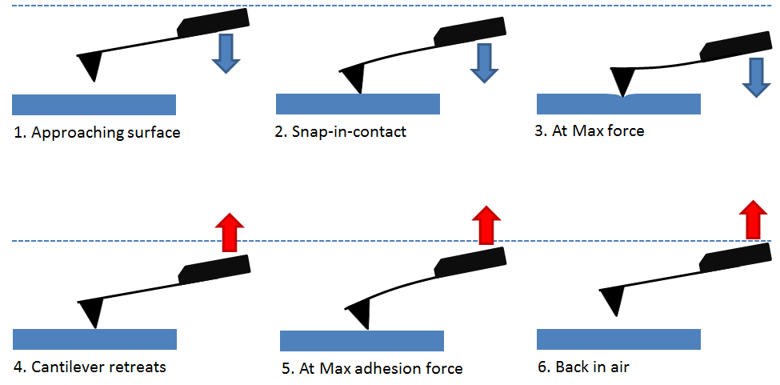
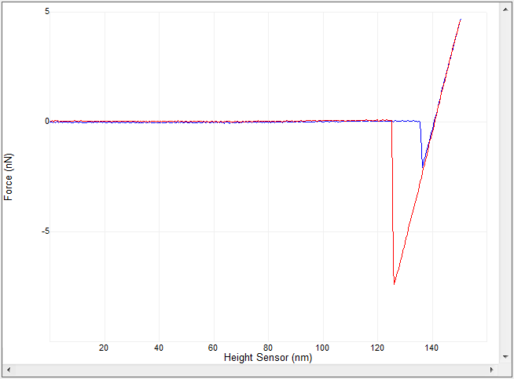
Force Distance Curve
3
Approach
1
Retract
4
6
2
5
6 Steps:
Approaching surface: no vertical cantilever deflection
Snap-in-contact: tip is pulled to surface suddenly by attractive force
At Max force: cantilever further moves down and reaches the force threshold
Cantilever retracts: cantilever retracts from the sample surface
At Max adhesion force: cantilever overcomes adhesion force and break off from surface
Back in air: cantilever back in free air, no vertical cantilever deflection

Slide 6
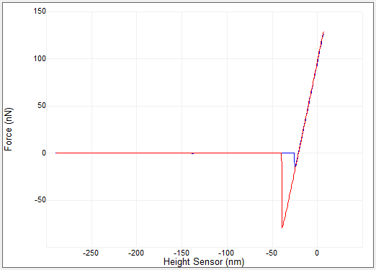
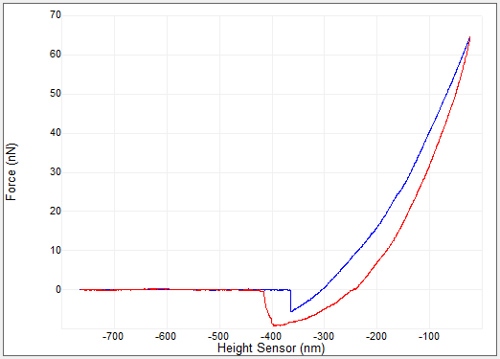
Force Curve Interpretation
Question: What is the difference between above two force curves?

Slide 7
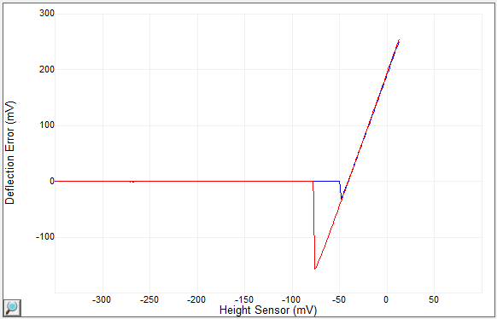
Sample Adhesion Force
The minimum deflection point on the retract plot is the maximum adhesion force.
Without calibration, ramp curve give Deflection vs. Z
Deflection raw unit is in V
How to convert Deflection from V to nm?
How to convert Deflection in nm to Force in nN?

Slide 8
Young’s Modulus
E=$\frac{tensile stress}{extensional strain}=\frac{σ}{ε}=\frac{F/A_{0}}{∆L/L_{0}}=\frac{FL_{0}}{A_{0}∆L}$
F
Where
E is the Young’s modulus (Modulus of elasticity)
F is the force exerted on an object under tension
A₀ is the area where is force is applied
ΔL is the length change of the object
L₀ is the original length of the object
ΔL
A₀
L₀
Young’s Modulus of Common Materials
Material | GPa | Material | GPa
Rubber | 0.01–0.1 | HOPG (C) | 18
PTFE (Teflon) | 0.5 | Aluminum (Al) | 69
Low density polyethylene | 0.11–0.45 | Titanium (Ti) | 110
High density polyethylene | 0.8 | Copper (Cu) | 117
Polystyrene | 2.5–3.5 | Silicon (Si) | 130–185
Nylon | 2–4 | Tungsten (W) | 400–410
Oak wood (along grain) | 11 | Single-walled carbon nanotube (C) | 1,000
Fused silica | 72 | Graphene (C) | 1,050
Sapphire | 460 | Diamond (C) | 1,220

Slide 9
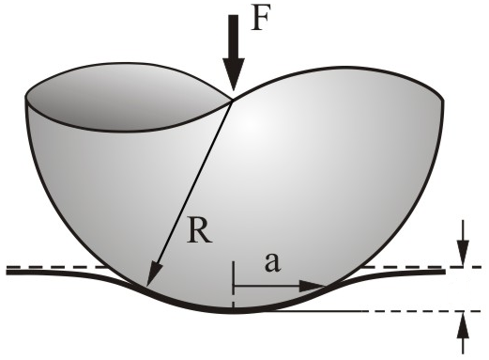
Sample Modulus: Hertzian Model
$$F=\frac{4}{3}\frac{E}{\left(1−ν^{2}\right)}\sqrt{R}δ^{3/2}$$
$${\left(F\right)}^{2/3}={\left(\frac{4}{3}\frac{E}{\left(1−ν^{2}\right)}\sqrt{R}\right)}^{2/3}δ$$
or
Linearized Equation
Where
F is the force (from force curve)
E is Young’s modulus (fit parameter)
v is Poisson’s ratio (typically 0.2-0.5)
R is the radius of the indenter (tip)
$δ$ is indentation depth
$$δ$$
Model is valid for a<<R
DMT model: Hertzian model with adhesion force
Linearized model is more robust, no need to find contact point
Question: if we use a 5um radius sphere probe to indent into sample surface by 50nm, which makes the contact area radius about 700nm, what is the tip radius R for above equation?

Slide 10
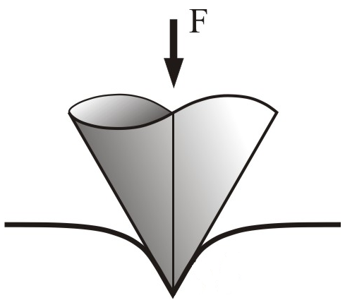
Sample Modulus: Sneddon Model
$$F=\frac{2}{π}\frac{E}{\left(1−ν^{2}\right)}tan⁡(α)δ^{2}$$
$${\left(F\right)}^{1/2}={\left(\frac{2}{π}\frac{E}{\left(1−ν^{2}\right)}tan\left(α\right)\right)}^{1/2}δ$$
or
Linearized Equation
Where
F is the force (from force curve)
E is Young’s modulus (fit parameter)
v is Poisson’s ratio (typically 0.2-0.5)
α is half angle of the indenter
$δ$ is indentation depth
α
$$δ$$
Used for large sample indentation
Uses approach curve, includes plastic deformation
Question: is $δ$same as the Z scanner movement after tip contacts sample surface?

Slide 11
Indentation Depth
Scanner move in Z
Cantilever Deflection
Sample Indentation
During contact
Scanner movement in Z($↓$) direction causes cantilever deflection($↑$) and sample indentation ($↓$)
Z = Sample Indentation + Cantilever Deflection Change
Separation= Z- Cantilever Deflection Change
Tip actual travel position with max indentation point as reference
Indentation Depth: amount of Separation change after initial contact (indentation depth should be always positive)

Slide 12
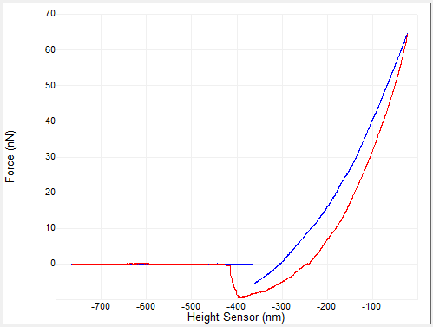
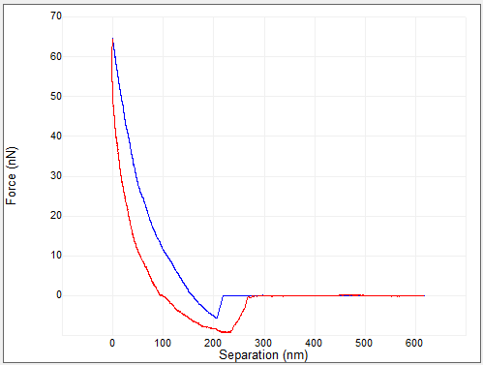
Force-Distance vs. Force-Separation
Force-Distance curve needs to be converted to Force-Separation curve before fitting with the contact model equations

Slide 13
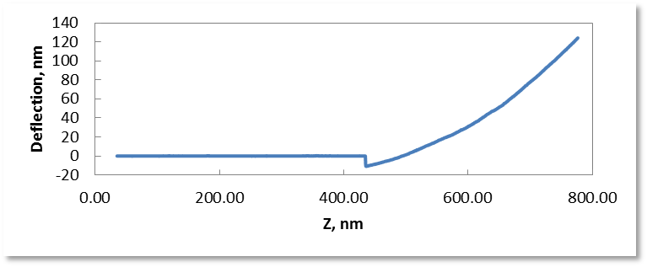
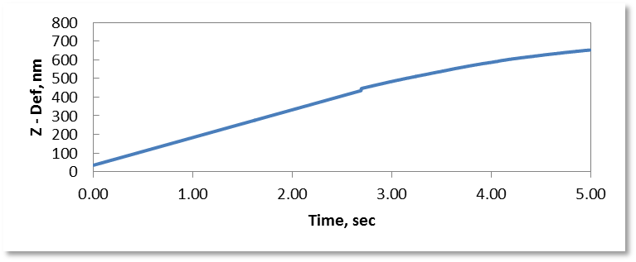
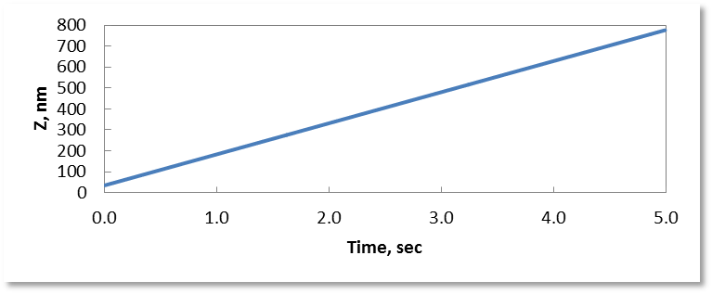
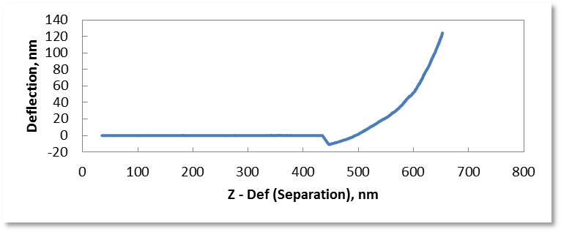
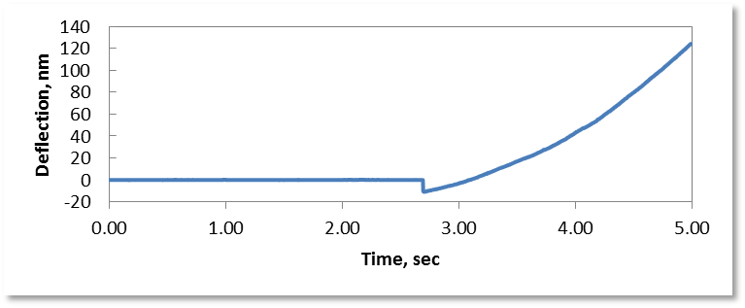
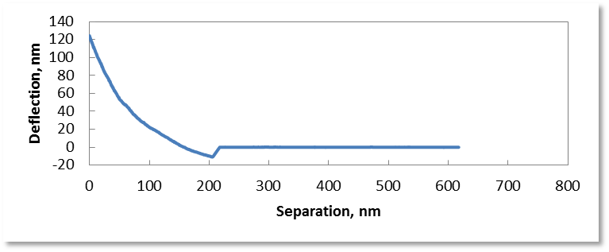
How to Convert Force Curves

Slide 14
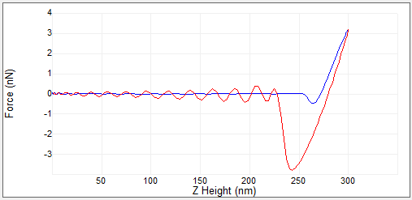
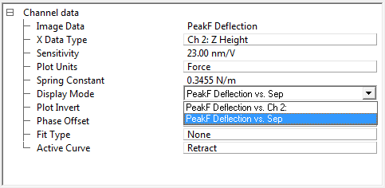
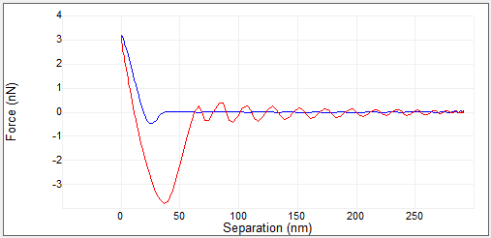
Force vs. Separation Curve
Force vs. Z
Force vs. Z curve needs to be converted into Force vs. Sep curve in order to be fitted by the contact models
This conversion can be easily done in Nanoscope Analysis software
Force vs. Sep

Slide 15
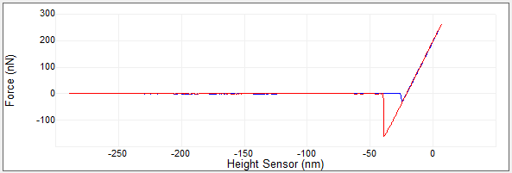
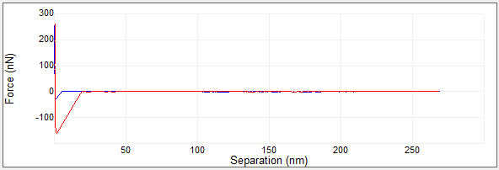
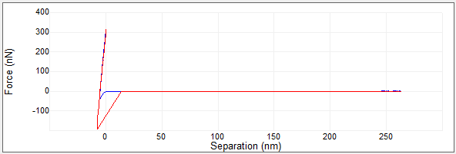
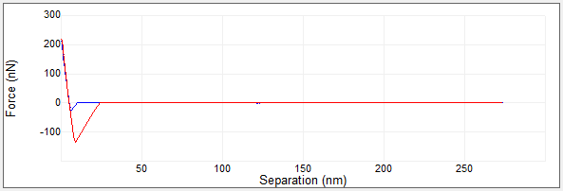
Example separation curves
Force vs. Z
Force vs. Sep #1
Force vs. Sep #2
Force vs. Sep #3
The above Force vs. Z curve is obtained by a soft cantilever ramp on a very hard sample, e.g. a ScanAsyst-Air probe on Sapphire sample
Questions: Which of the above Force vs. Sep curves is correct?

Slide 16
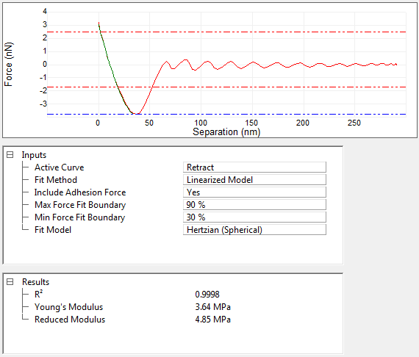
How to get modulus from force curve: DMT Model
Click (Indentation) for force curve analysis
DMT Model:
Use retract curve
Fit with linearized model
Include Adhesion Force: F=F_{tip}-F_{adh}
Use Hertzian (Spherical)
Set force fit region
Young’s Modulus E and Reduced Modulus E*:
$$E^{∗}={\left[\frac{1−{ν_{t}}_{}^{2}}{E_{t}}+\frac{1−{ν_{s}}_{}^{2}}{E_{s}}\right]}^{−1}$$
If E_{t}>>E_{s}
$${ E}^{∗}=\frac{E_{s}}{1−{ν_{s}}^{2}}$$

Slide 17
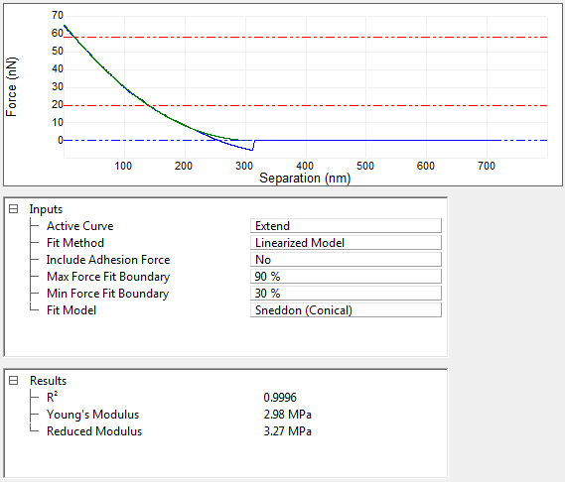
How to get modulus from force curve: Sneddon Model
Sneddon Model:
Indentation should >> tip radius
Use Extend curve
Fit with linearized model
Don’t include Adhesion Force
Use Sneddon (Conical)
Set force fit region
Typically used for cell or gel in liquid

Slide 18
Cantilever Selection
Method_1
$$F=Deflection∗K=\frac{4}{3}\frac{E}{\left(1−ν^{2}\right)}{\sqrt{R}δ}^{3/2}$$
Method_2
Cantilever spring constant needs to match with the sample modulus
For accurate modulus measurement, the amount of sample Indentation(at least 2-5nm) should be greater than cantilever deflection
Cantilever Deflection =< Sample Indentation
Question: What spring constant to choose to measure 10MPa modulus with a 5um diameter sphere probe?

Slide 19
Deflection Sensitivity Error Transfers into Indentation Depth Error
Z
D
δ
Z scanner moves: Z
Cantilever Deflection: D
Indentation depth: δ=Z-D
Deflection Sens. calibration error (relative, %): e
Measured Deflection: (1+e)D
Calculated Indentation depth: Z-(1+e)D
Indentation depth error (relative,%):eD/(Z-D)=e(D/δ)
The Indentation Depth error (%) introduced by Deflection Sensitivity error could be amplified by a factor of (D/δ)

Slide 20
PF-QNM

Slide 21
Peak Force Tapping
One cycle: photo detector vertical deflection (force) vs time.
A/E
C
Amp.
Peak Force
C
A - Probe tip 300 nm above sample surface (150nm PFT amplitude). Z piezo pushes probe toward sample.
B - Tip contacts sample (“snap-to-contact”). Z piezo pushes probe further until reach PeakForce.
C – After PeakForce position, probe starts withdrawing from sample.
D – Probe tip breaks free off sample at maximum adhesion point.
E – Probe back to starting point 300 nm above sample surface
Probe repeat the cycle A->E cycle at fixed frequency, typically 2KHz

Slide 22
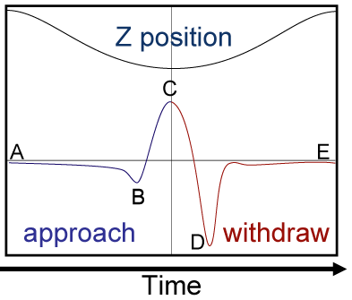
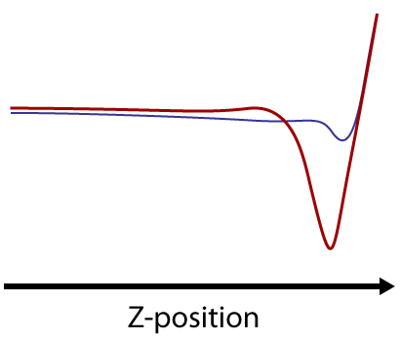
Difference Between PF-Tapping and FD Curve
Sine wave drive signal, 2KHz vs. triangular wave drive signal, ~2Hz
Sync distance + feedback vs. trigger threshold
Real-time background subtraction vs. offline baseline correction
Advanced real-time data analysis vs. offline analysis
Faster speed and higher resolution image
Accurate force control and gentler tapping
Real time high resolution mechanical properties mapping

Slide 23
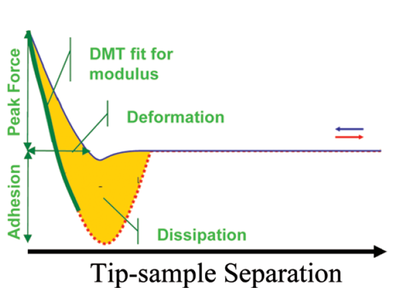
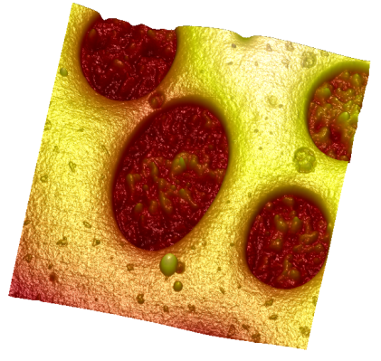
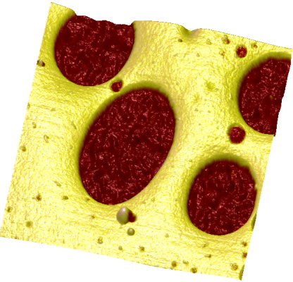
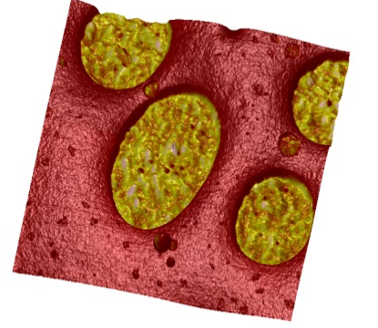
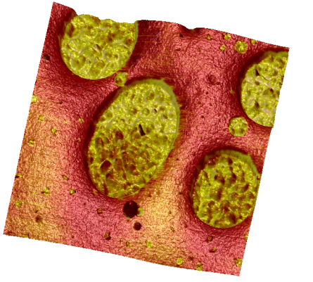
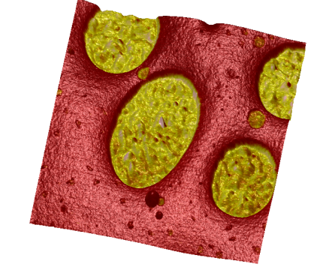
PeakForce QNM Data Channels
Height
Modulus
Indentation
Adhesion
Dissipation

Slide 24
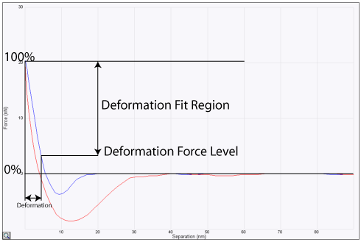
Deformation
Indentation
Softer sample has higher deformation
Deformation calculation use approach force curve
Deformation calculation generally underestimates sample indentation
Since Deformation is based on Separation plot, it needs accurate Deflection Sensitivity

Slide 25
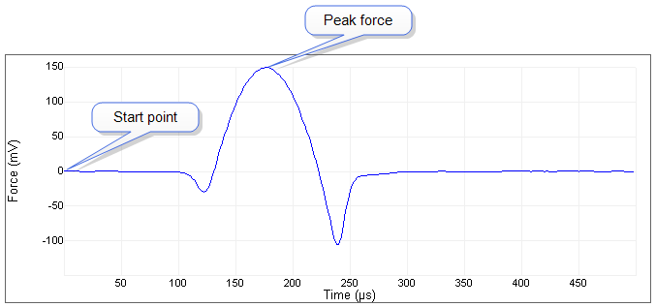
PFT Parameters: 1. Sync Distance
Sync Distance is a time constant during each tapping cycle when cantilever reaches the lowest position.
On hard sample deflection reaches max when piezo extends to lowest position.
In QNM analysis, Sync Distance or PeakForce position is used as the turning point between approach force curve and retract force curve.

Slide 26
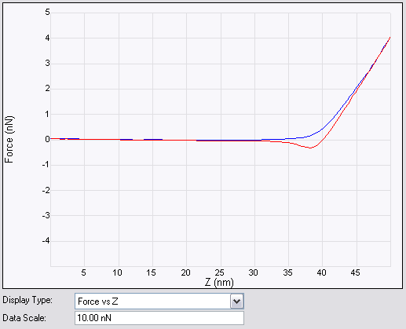
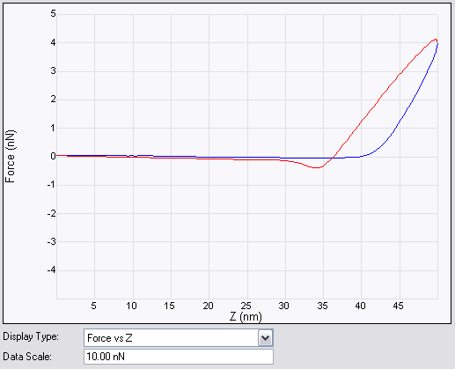
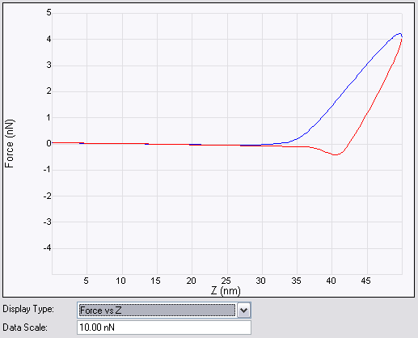
Typical Sync Distance Problems
Two common “Sync” problems
Late sync- approach curve contains decreasing force before turnaround. Might not be a problem – could be due to sample viscoelasticity
Early sync- retract curve contains increasing force at beginning of turnaround.
Use Auto Config button on hard sample to measure sync distance
Sync correct
Sync too early
Sync too late

Slide 27
PFT Parameters: 2. PeakForce Setpoint
Set ScanAsyst control to Individual
OK to engage with all (setpoint, gain, scan rate, z limit) On
After engaged and stable turn auto setpoint Off
Use setpoint to control Indentation Depth
Effective tip radius depends on Indentation Depth
Adjust the setpoint to have at least 2-5nm indentation for DMT model. For Sneddon model, Indentation should be larger, i.e. >30nm

Slide 28
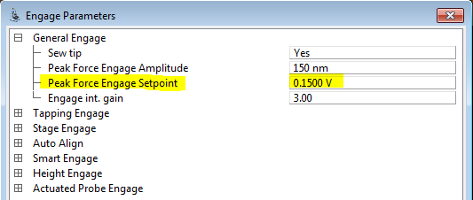
PFT Parameters: 3. Engage Force
Engage ignores Peak Force Setpoint
Doesn’t matter if ScanAsyst Auto Setpoint is On or Off.
For engaging the Peak Force Engage Setpoint (in other controls) is used.
Default .15 V
OK for soft probe, e.g. ScanAsyst Air
Try .05 V for stiff probes, e.g. RTESPA

Slide 29
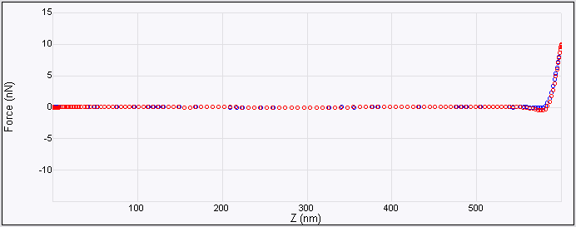
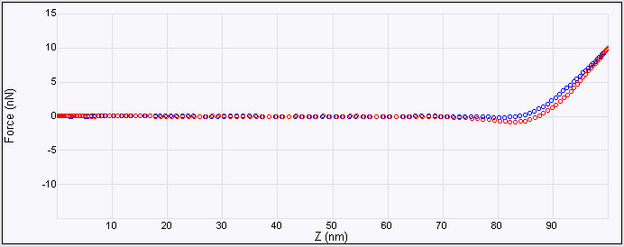
PFT Parameters: 4. Amplitude
Amp 300nm
Amp 50nm
Amplitude combined with setpoint determines the contact time ratio
Recommended contact time 10-30%
Higher contact time ratio means more data point in contact region
Higher amplitude sometime is needed to overcome large adhesion force

Slide 30
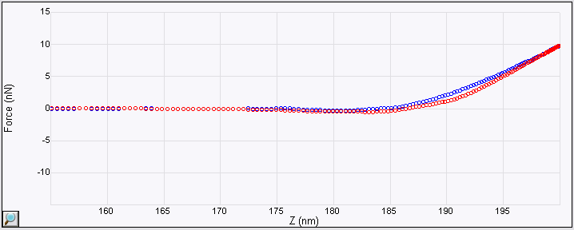
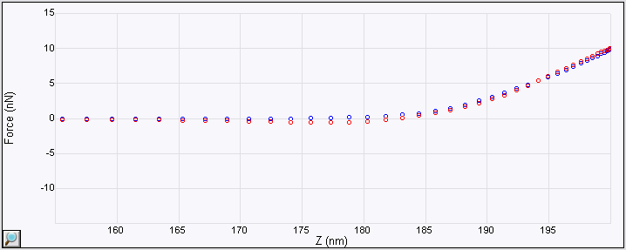
PFT Parameters: 5. Frequency
500Hz
2000Hz
Default for Icon and MM is 2KHz, MM HR and Fast Scan is 8KHz
Higher frequency can scan faster and/or higher resolution for topography
Lower frequency means more data points in each force
Lower frequency is preferred for fluid imaging, less hydrodynamic background
DSP analyzes force curve at 1KHz with current software (V8.15, V9.0, and V9.1)

Slide 31
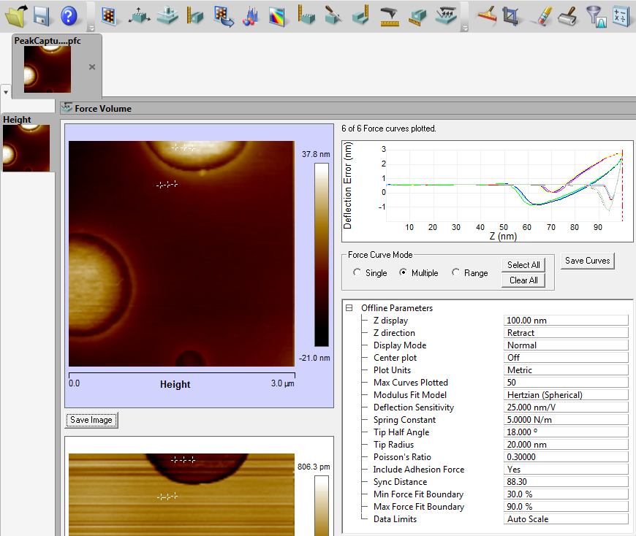
Peak Force Capture
One force curve at each image pixel can be capture with PeakForce Capture
Calibration parameters can be re-adjusted to data channels, e.g. modulus

Slide 32
PF-QNM Calibrations

Slide 33
Calibration Parameters
α
$$δ$$
$$δ$$
$$F=\frac{4}{3}\frac{E}{\left(1−ν^{2}\right)}R^{1/2}δ^{3/2}$$
$$F=\frac{2}{π}\frac{E}{\left(1−ν^{2}\right)}tan⁡(α)δ^{2}$$
Deflection Sensitivity
Spring Constant
Tip Radius or tip half angle
Sample Poisson’s Ratio (material property, typically 0.2-0.5, 0.5 for cell)

Slide 34
PF-QNM Calibration
Deflection Sensitivity
Spring Constant
Tip Radius

Slide 35
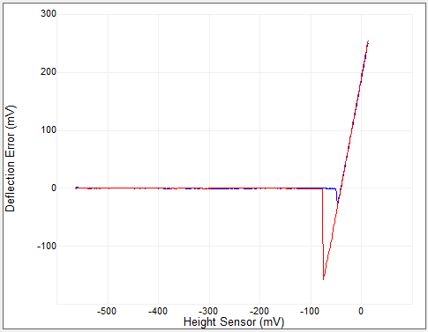
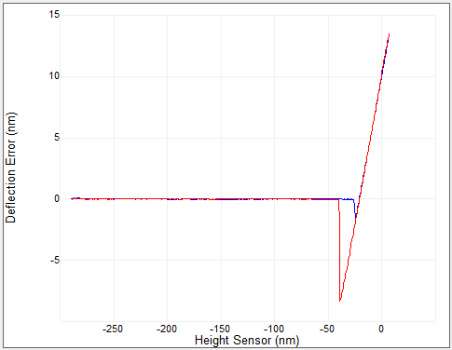
What is Deflection Sensitivity
AFM reads cantilever deflection in V
Deflection Sensitivity converts deflection in V into deflection in nm
Deflection Sensitivity unit: nm/V
Deflection Sensitivity depends on: 1. cantilever type, 2. instrument type, 3. laser alignment, 4. surrounding media (air or fluid)
Question: 50nm/V and 100nm/V, which one is better Deflection Sensitivity?
Question: Shorter or longer cantilever has better Deflection Sensitivity?

Slide 36
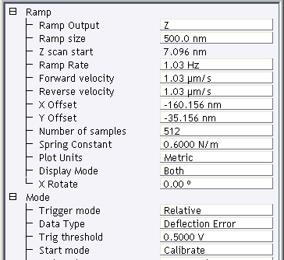
Def. Sens. Calibration Using Force Ramp
Open PeakForce QNM In Air experiment.
Load fused silica or sapphire sample.
Engage
Scan 1um area to make sure center of the image (where is ramp will be performed) is flat and clean. Offset and/or zoom if needed.
Switch to Ramp Mode
Configure ramp params
Trigger Threshold
ScanAsyst Air or Tap150A - 0.2V
RTESPA or Tap525 - 0.1V
Reduce the ramp size to get enough data points in contact part of the curve
Analysis data in either Nanoscope or Nanoscope Analysis

Slide 37
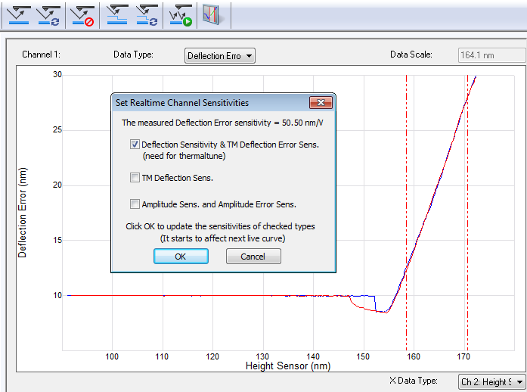
Def. Sens. Cal. in NanoScope
Deflection Sensitivity can be calibrated in Nanoscope software
After click “OK”, it will be updated in software automatically

Slide 38
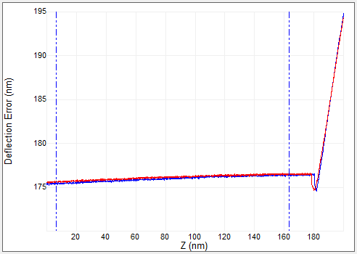
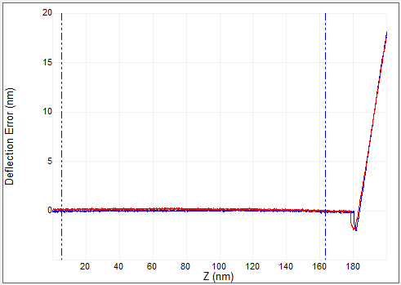
Def. Sens.: Baseline Correction
Before correction
After correction
Because of the optical interference or long range force (magnetic or electric static force), the baseline of the force curve may not be flat.
Save the ramp curve, and open it in Nanoscope Analysis
Click on , define baseline fit region, then correct the baseline
Notes:
Tip: Updating def. sens. in captured ramp files only saves the value in that file. The final value will need to be manually entered into the detector calibration window
Tip: Calibrate deflection sens. from captured ramps because:
Doing so from real-time ramp only uses 2 points for the line fit.
Doing so offline uses multiple points for the line fit.
Click ramp single then click capture to capture the ramp.
Repeat two more time so that 3 ramps are captured.

Slide 39
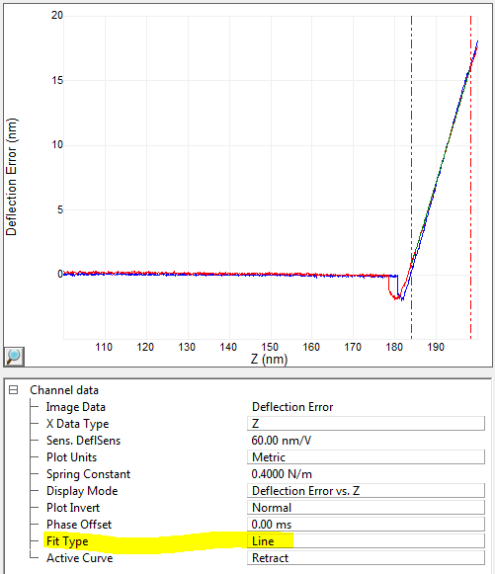
Def. Sens.: Update Sensitivity with Line Fit
Acquire at least 3 ramp curves, and calculate the average deflection sensitivity, then type manually in Calibrate window
Confirm deflection sensitivity: If it is a standard probe, compare with factory value

Slide 40
Deflection Sensitivity Error Transfers into Indentation Depth Error
Z
D
δ
Z scanner moves: Z
Cantilever Deflection: D
Indentation depth: δ=Z-D
Deflection Sens. calibration error (relative, %): e
Measured Deflection: (1+e)D
Calculated Indentation depth: Z-(1+e)D
Indentation depth error (relative,%):eD/(Z-D)=e(D/δ)
The Indentation Depth error (%) introduced by Deflection Sensitivity error could be amplified by a factor of (D/δ)

Slide 41
PF-QNM Calibration
Deflection Sensitivity
Spring Constant
Tip Radius

Slide 42
Spring constant: Thermal Tune, K<1N/m
$$k=\frac{0.971k_{B}T}{χ^{2}\left\langle {Z_{1}}^{∗2}\right\rangle }$$
k, Spring constant
T, Temperature
k_{B,} Boltzmann constant, (1.38·10⁻²³ J/K)
Z₁^{*2}, Mean square cantilever displacement
𝜒, Deflection sensitivity correction factor, 1.09
First make sure deflection sensitivity and thermal tune gains are calibrated corrected.
Withdraw the probe from sample for thermal tune.

Slide 43
Spring Constant: Sader Method
$$k=7.5246ρfw2LQf02Γi(Re)$$
$$Re=\frac{2πρ_{f}f_{0}w^{2}}{4η_{f}}$$
Sader Method: rectangular shape ( free iPhone App “Sader Method” )
Length and Width can be optically measured with good accuracy
Resonance frequency and Q factor can be obtained from thermal (recommend) or mechanical tune

Slide 44
Spring constant: other methods
Dimensional Models
Dimensional model Simple Beam or Frequency scaling: Rectangular shape
Simple Beam Method Frequency Scaling Method
Static Deflection Measurements
Reference cantilever method: 0.3K_{ref}<K<3K_{ref}, all shape
Bruker supplies calibrated reference probe, model: CLFC-NOBO, which consists three cantilevers with nominal spring constant at: 0.16N/m, 1.3N/m, and 10.4N/m, respectively
Application Notes_094

Slide 45
PF-QNM Calibration
Deflection Sensitivity
Spring Constant
Tip Radius

Slide 46
Tip Radius for DMT Model
R
For spherical probe, the tip radius is independent to the indentation depth
For conical probe that tip end is not a part of a sphere, the effective tip radius depends on indentation depth
Two information needed to calibrate tip radius:
Tip shape
Indentation depth

Slide 47
Determining Tip Radius with Tip Qual
Acquire an Tip Check sample image with parameters as shown
Open the captured image with NanoScope Analysis
Set Plane Fit Mode to 1st order XY plan fit
Note: Using tapping mode for very stiff probe, e.g. DNISP, RTESPA-525

Slide 48
Determining Tip Radius with Tip Qual
Tip Qual Icon
Click the Tip Qual Icon
Set Tip Image Size to 100 nm
LPF for max select On
Click on Estimate Tip
An image of the Tip now appears in the image window

Slide 49
PFQNM – How To – HSDC & PFQNM Offline (how to determine true indentation depth)
Capture an image on the unknown sample.
While the image capture is in progress press the Capture Line button on the Force Monitor to capture lines of raw data.
Click Upload Data button to save the raw HSDC data to a file.

Slide 50
Indentation depth : Deflection vs. Separation plot of HSDC
The distance on a Deflection vs. Separation plot’s load (extend) curve starting at the “snap-to-contact” point and ending at z fully extended.
Use HSDC and QNM HSDC-ForceCurve analysis to export force curve(s) and then reload to display separation plot
The force monitor Force vs. Z is a good approximation only if the cantilever deflection is small compared to the deformation
Indentation from deflection vs. separation plot load curve

Slide 51
Determining Tip Radius with Tip Qual
Enter the average indentation depth into Height 1 or Height 2 From Apex
Click Qualify Tip
Read the corresponding Estimated End Radius (not ETD or ETD/2)
Enter Tip Radius into “Cantilever Parameters / Tip Radius” in real time software
Question: If we use a 5um diameter sphere probe, how to calibrate the tip radius?

Slide 52
PF-QNM Calibration: Other Parameters
Other Parameters
Sync Distance
Drive3 Amp. Sens.

Slide 53
1. QNM Sync Distance Calibration (What is Sync Distance)
Sync Distance is a time constant during each tapping cycle when cantilever reaches the lowest position.
On hard sample deflection reaches max when piezo extends to lowest position.
In QNM analysis, Sync Distance or PeakForce position is used as the turning point between approach force curve and retract force curve.

Slide 54
1. QNM Sync Distance Calibration (V9 or later Nanoscope software)
If it is difficult to determine the Sync Distance for the unknown sample, do the following:
There are two Synch distance (V9)
Sync Distance New (for imaging only)
Sync Distance QNM
Use the same probe to calibrate the Sync Distance QNM on a hard elastic sample use auto config, and write it down. (may do this right after deflection sensitivity calibration)
Manually type this Sync Distance QNM in Nanoscope software for the unknown sample

Slide 55
2. Drive3 Amplitude Sensitivity Calibration (how the modulation is driven in QNM)
Regular Z ramp curve
& Deflection Sens. Cal
Z Scan DAC
+
Z Piezo
PF-QNM force curve
DDS3
Z Offset DAC
Reasons why need Drive3 Amp. Sens. Calibration:
Deflection sensitivity calibration (regular Z ramp) and PF-QNM force curve uses different DAC to generate the drive signal
In some case (e.g. Icon Scanner at 2KHz), the Drive3 amplitude sensitivity maybe frequency dependent, and can be calibrated or manually adjusted
Petri Dish drum effect will cause Drive3 amplitude sensitivity to change

Slide 56
2. Drive3 Amplitude Sensitivity Calibration (What is Drive3 Amp. Sens.)
By default, the Drive3 Amplitude Sensitivity is calculated from Z scan sensitivity
But Drive3 Amplitude Sens. Can be independently calibrated or manually typed in
Reloading the workspace or software will set Drive3 Amplitude Sens. to default value

Slide 57
2. Drive3 Amplitude Sensitivity Calibration (V9 and Later Nanoscope software)
Two ways to calibrate the Drive3 Amplitude Sensitivity:
In ramp mode: get ramp curve and update deflection sensitivity in Nanoscope SW, then calibrate DDS3 drive amplitude sensitivity when message pops up
After measuring the deflection sensitivity in ramp mode, return to scan mode and with PeakForce setpoint>0.1V, click “Update Sensitivity” in PF-QNM force window

Slide 58
2. Drive3 Amplitude Sensitivity Calibration (V8.15 and Later Nanoscope software)
Make sure deflection sensitivity is already calibrated
PeakForce Tapping on hard surface (same sample used for Def. Sen. calibration)
Set PeakForce Setpoint to 0.1-0.2V
Click “Auto Config” to make sure Sync Distance is correct
Click “Capture Line” to Capture force curve
Open the HSDC data in Nanoscope Analysis, and export a force curve

Slide 59
2. Drive3 Amplitude Sensitivity Calibration (V8.15 and Later Nanoscope software)
New calibrated Drive3 Amp. Sen.
=612.6nm/V*1.0763
=659.3nm/V
Open the saved force curve in Nanoscope Analysis; line fit the contact region of the retract curve, and get the slope of the fitted curve (e.g. 1.0763)
Click “Calibrate”>>”Property Maps” to find the current Drive3 Amp. Sens.
New “Drive3 Amp. Sens.”=“fitting slope”*current “Drive3 Amp. Sens.”
Type new “Drive3 Amp. Sens.” (e.g. 659.3nm/V) to “Property Maps”, and click “OK”

Slide 60
2. Drive3 Amplitude Sensitivity Calibration (V8.15 and Later Nanoscope software)
Do a new Capture Line, then open the HSDC data in Nanoscope Analysis and export a representative force curve
Line fit the contact part of the exported force curve, now the slope should be close to 1.0
Now “Drive3 Amp. Sens.” is calibrated

Slide 61
2. Calibrate Drive3 Amplitude Sensitivity (With Z sensor HSDC)
Make sure the Z sensor is calibrated correctly

Slide 62
New Software Interface

Slide 63
Relative Method
$$DMT Model: F=Def. ∗K=\frac{4}{3}\frac{E}{\left(1−ν^{2}\right)}R^{1/2}δ^{3/2}$$
E~ k/√R (E=modulus, k=spring constant, R=tip radius)
Main differences between “relative” and “absolute” methods.
Absolute method requires direct measurement of k and R
R must be evaluated at indentation depth
If indentation depth changes R can be re-evaluated, but modulus is only weakly dependent on R
Relative method uses reference sample to force the ratio of k/√R to be correct at a given indentation depth.
To get modulus of unknown sample adjust setpoint until the indentation depth is close to that used to establish k/√R on the reference sample.
Reference sample should have similar modulus as unknown sample
Question: how to make sure the indentation depth is close to that on reference sample?

Slide 64
PF-QNM Procedure
Absolute Method
Calibrate Deflection Sensitivity
Calibrate Drive3 Amp Sensitivity and QNM Sync Distance
Calibrate Spring Constant
Image on the tip check sample, if tip radius needs to be calibrated
Switch to the unknown sample
Manually adjust the PeakForce setpoint to get 5-10nm deformation
Capture HSDC data on unknown sample
Measure Indentation Depth
Open tip check image in Nanoscope Analysis, and use Indentation depth to get the tip radius
Type in the tip radius in Nanoscope software and get the sample modulus
Relative Method
Calibrate Deflection Sensitivity
Calibrate Drive3 Amp Sensitivity and QNM Sync Distance
Load a reference sample with known modulus
Manually adjust the PeakForce setpoint to get 5-10nm deformation
Type in an estimated spring constant (i.e. nominal value)
Adjust the tip radius so that the measured modulus is close to expect value
Record the average deformation
Switch to unknown sample
Only adjust the PeakForce setpoint so that the average deformation is same as on reference sample
The measured modulus is the unknown sample modulus

Slide 65
QNM High Accuracy

Slide 66
QNM Improvements: DNG-QNM
Improvements:
Pre-calibrated probes (K & R)
Probe holder
Samples & Sample Mount
QR Reader
Software Features
Benefits:
Simpler calibration procedure
More repeatable measurements, 20% 1σ
Works for heterogeneous sample

Slide 67
New QNM Probes
4 new QNM probes
SAA-HPI-30 (1MPa – 100MPa)
RTESPA-150-30 (10MPa – 1GPa)
RTESPA-300-30 (100MPa – 10GPa)
RTESPA-525-30 (>1GPa)
Pre-calibrated spring constant
Controlled tip radius: 33nm
For air operation only
Calibration data in QR code

Slide 68
Samples
4 Reference samples
PDMS-SOFT, 5.0MPa (QNM 2KHz)
PDMS-MED, 84MPa (QNM 2KHz)
Polycarbonate, 2.4GPa
Fuse Silica, 76GPa
Tip cleaning sample: Tipcheck
Touch Cal sample: Sapphire

Slide 69
Sample Holder
Sample holder can accommodate 3 samples: 1 reference sample, sapphire, tip check sample
Sample physical positions to match with layout in SW
Magnetically mount to standard Icon chuck
Compatible with HC or CR mounts

Slide 70
Probe Holder
✗
✓
A modified DAFMCH holder is used for QNM
Modification: removed the tail part of the spring clip
This modification removes the ~2KHz rocking motion of the probe holder during QNM
This enables the DDS3 calibration using Height Sensor

Slide 71
QR Reader
Use QR reader to retrieve probe calibration information
Key the probe calibration to use on Bruker AFM only

Slide 72
Software Feature
9.4 Nanoscope software
QNM related new features:
Probe specific and pre-defined parameter settings
Easy sample Navigation
Intuitive workflow UI interface for QNM calibration
DDS3 calibration using Height Sensor
Tip cleaning function
Indentation data channel

Slide 73
Enable Sample Navigation
Start/Close Nanoscope after installing new 9.4 SW to update system.par file
Change “Has 3 QNM Samples” to “Yes”
Manually move to each sample to teach sample position
Reload wks or change probe will reset Z but keep XY for taught sample positions

Slide 74
Touch Probe Calibration
1
2
3
4

Slide 75
Advanced Probe Calibration
Freq Based QNM Cal

Slide 76
Software Parameters
Peak Force Freq.: 2KHz
SyncDistance Display:
Percentage
Data Points
Use Freq Based QNM Cal:
Off
PFT Ampl Sens Only
SyncDistQNM Only
Ampl Sens & SyncDistQNM
Max/Min Force Fit Boundary: 5%-100%
Dynamic Sync Distance: Off
Auto PFT Ampl. Sens: On or Off

Slide 77
Recommended Settings for Different Probes
Polycarbonate
QNM Probe | Reference Sample | FV Force Setpoint (nN) | PFQNM Force Setpoint (nN) | 1Hz FV Modulus | 2KHz QNM Modulus | Indentation Depth (nm)
SAA-HPI-30 | PDMS-SOFT | 1 | 1 | 2.5MPa | 5MPa | 40
RTESPA-150-30 | PDMS-MED | 5 | 5 | 22.5MPa | 37.5MPa | 12
RTESPA-300-30 | PC-12M | 20 | 20 | 2.4GPa | 2.4GPa | 1.5
RTESPA-525-30 | FSILICA-12M | 250 | 250 | 76GPa | 76GPa | 1.0

Slide 78
PS-LDPE QNM Measurement
RTESPA-300-30 probe
PeakForce setpoint 10nN

Slide 79
Offline Analysis

Slide 80
Troubleshooting: Check Sync Distance
Sync Distance has big impact on measured modulus

Slide 81
Troubleshooting: Check FV data
Use FV data to check if probe calibration is correct
Need to consider visco-elasticity when compare

Slide 82
Troubleshooting: Check Separation Curve
Normal
Wrong
Use Capture Line or Peakforce Capture function to capture raw QNM force curve
Open force curve in Nanoscope Analysis, and convert to Separation curve

Slide 83
Troubleshooting: Check PFT Amplitude
Make sure Z sensor is calibrated correct
Z sensor HSDC data to check the actual PFT Amplitude

Slide 84
Troubleshooting: Tip Contamination
Contaminated tip
After tip cleaning
33nm tip on clean surface (e.g. Sapphire) should have ~10nN adhesion force

Slide 85
Summary
Three basic Calibrations: Defl. Sens., Sprint Constant, Tip Radius
Two advanced Calibrations: DDS3 Sens., Sync Distance (QNM)
Cantilever spring constant needs to match the sample modulus, relative stiff cantilever is better
Manual control PeakForce setpoint for QNM
Make sure sync distance is correct
Need to have enough Deformation (at least 2-5nm)
Pre-Calibrated probes are highly recommended

