Slide 1
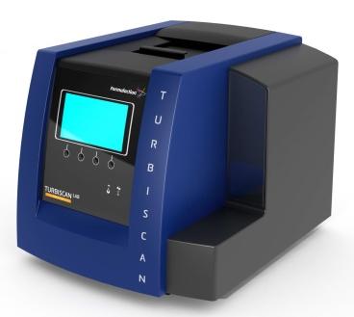
Turbiscan安装培训
大昌华嘉科学仪器部
韩斅
北京，2020
咨询电话：18611896212
咨询邮箱：shawn.han@dksh.com
Notes:
Hello, everyone. Please let me introduce you the Turbiscan technology. It’s based on multiple light scattering. It is the leader of stability market of concentrated dispersion since more than 20 years. The instruments are especially useful to identify and to follow the destabilization phenomena (migration or variation of size) of complex systems. It’s great interest to be able to analyze concentrated samples without dilution.

Slide 2

目录
配方工作中面临的挑战
如何解读Turbiscan图谱
数据分析实际案例

Slide 3
什么是物理稳定性

Slide 4
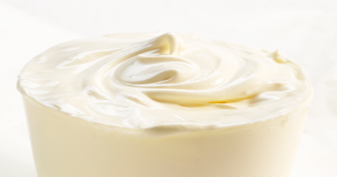

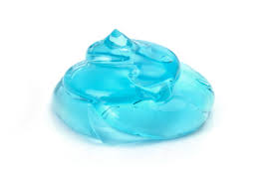


PHYSICAL STABILITY
Introduction
What is a liquid dispersion ?
A mixture
Stable
Multiple ingredients, non miscible phases
(dispersed phase and continuous phase)
For user appreciation the formulation must remain stable
Different types
Liquid/liquid = emulsion
Solid/liquid = suspension
Gas/liquid = foam
© Copyright PresentationGo.com

Slide 5
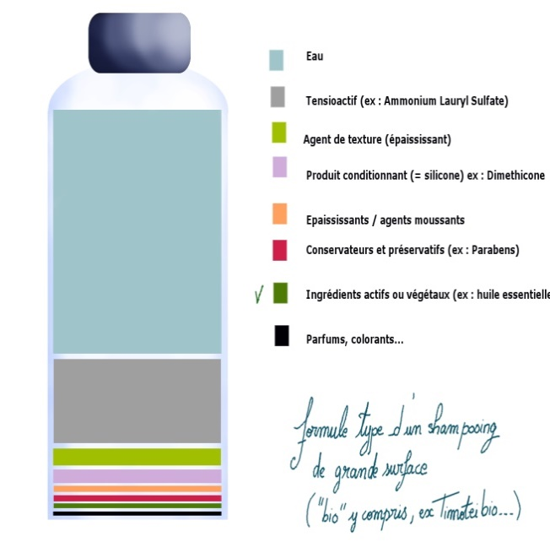
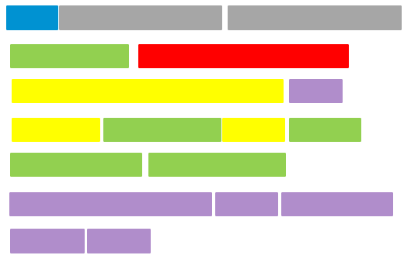

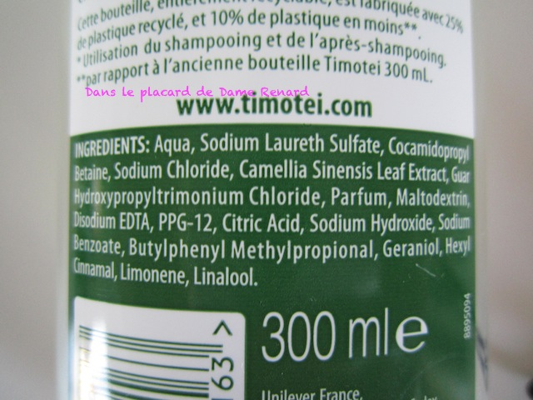
PHYSICAL STABILITY
Introduction
What is Formulation?
The formulation of something (medicine, food, beauty product etc.) is the way in which different ingredients are combined to make it. You can also say that the finished product is a formulation .
Solvent
Aqua, Sodium Laureth Sulfate, Cocamidopropyl Betaine,
Sodium Chloride, Camellia Sinensis Leaf Extract,
Guar Hydroxypropyltrimonium Chloride, Parfum,
Maltodextrin, Disodium EDTA, PPG-12, Citric Acid,
Sodium Hydroxide, Sodium Benzoate,
Butylphenyl Methylpropional, Geraniol, Hexyl Cinnamal,
Limonene, Linalool.
Solvent
Surfactant
Auxiliary agents
Polymer
Active ingredient
Perfum

Slide 6

配方工作中面临的挑战
PHYSICAL STABILITY
Definitions
What is considered a Stable formulation ?
Dispersed phase will always present in different states / sizes in the continuous phase
Initial state
The system able to remain in the initial state:
particle size, homogeneity, sensorial properties, rheology, biology….
In practice, no such product exists
Every system evolves
These dispersions are unstable under the effect of temperature
BUT
It is the kinetic stability that will determine whether the formulation is acceptable

Slide 7
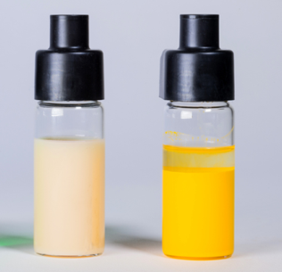
配方工作中面临的挑战
PHYSICAL STABILITY
Definitions
What is considered a Stable formulation ?
Particle size increase
Migration phenomena
Flocculation
Creaming
The system able to remain in the initial state:
particle size, homogeneity, sensorial properties, rheology, biology….
In practice, no such product exists
Every system evolves
Coalescence
Sedimentation

Slide 8

物理稳定性的定义
PHYSICAL STABILITY
Definitions
What is considered a Stable formulation ?
What acceptable means?
Stability criteria稳定性判据（准则）
Stability metrics稳定性指标（参数）
End user properties /expectations are met
The system to remain in the initial state…
Stability is a subjective measure and depends on:
Application and industry requirements
Company quality standard & product positioning (higher expectation for top of the range)…
… or with the alteration being acceptable over a specific time*
(*depending on the application)

Slide 9
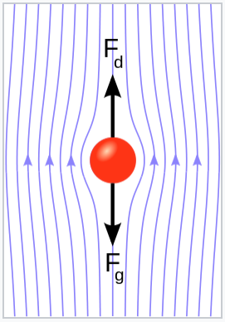

PHYSICAL STABILITY
Influence factors
Temperature
Room temperature
High temperature
Cycling of temperature
pH
zeta potential
Ionic strength
Salt
Particle size
Viscosity
Exposure to light
Stress
Vibration and Centrifugation

Slide 10
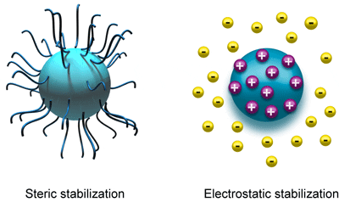
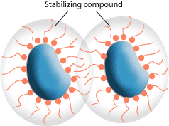
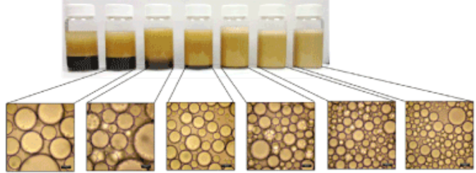
配方工作中面临的挑战
稳定性间接表征方法
Background on physical stability
Parameters
测量与产品物理性质和化学变化相关的仪器方法
  Stabilisation barrier
    Electrostatic repulsion
    Steric hindrance
  Size
  Rheological properties
  AND SO ON…
直接监测长期稳定性
Notes:
Let’s start with some background on physical stability.
The major parameters involved in the stabilization of dispersions (including emulsions, suspensions and foams) are:
- the stabilization barrier around the particles (droplets, particles, bubbles), meaning electrostatic (charge) and steric (space taken by the surfactant or polymer chains prevending aggregation) barrier.
- the size : the smaller the particles, the less sensitive to migration phenomena.
- the viscosity : increase of viscosity of the continuous phase, slows down migration and collision processes.
The actual test : bottle test

Slide 11

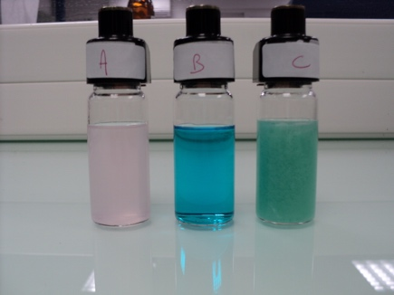
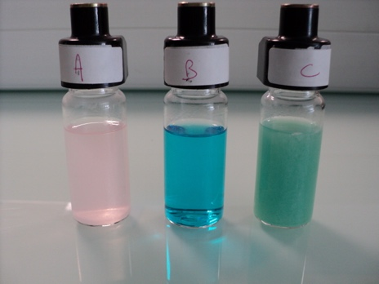
配方工作中面临的挑战
PHYSICAL STABILITY
Classical tests
Classical method for stability determination
BOTTLE TEST
Direct Method
Inexpensive
Corresponds to real conditions (no stress…)
But What if the change is not easily visible ??
Before
Bottle testing is not practical :
Not sensitive: may require several months and high temperature
Only sensitive to particle migration
Not Objective : Depends on the Operator
Doesn’t quantify the phenomena
After
Notes:
Let’s start with some background on physical stability.
The major parameters involved in the stabilization of dispersions (including emulsions, suspensions and foams) are:
- the stabilization barrier around the particles (droplets, particles, bubbles), meaning electrostatic (charge) and steric (space taken by the surfactant or polymer chains prevending aggregation) barrier.
- the size : the smaller the particles, the less sensitive to migration phenomena.
- the viscosity : increase of viscosity of the continuous phase, slows down migration and collision processes.

Slide 12
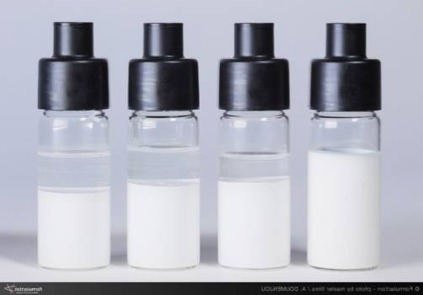
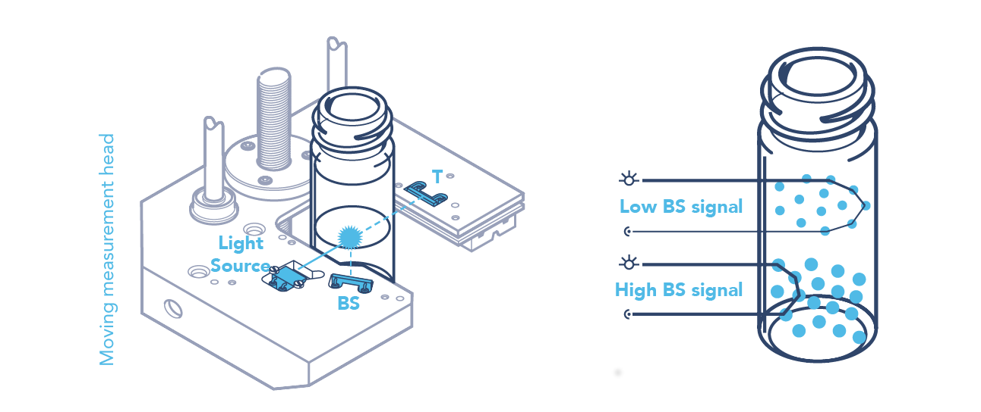

稳定性测试方法
TURBISCAN TECHNOLOGY
How to measured?
Sample
ISO TR 13097
ISO TR 18811
GB/T 38431
ASTM D7064
QB/T 5255
l*↑
No dilution
l*↓
Particle Migration speed
LED
Mie Theory
particles scatter the light
0.1μm/day
Detector
Average Particle Size
10nm to 1mm
Want to know more ? Visit our website and read our application notes
http://formulaction.com/en/applications-and-library/library

Slide 13
如何解读Turbiscan图谱

Slide 14
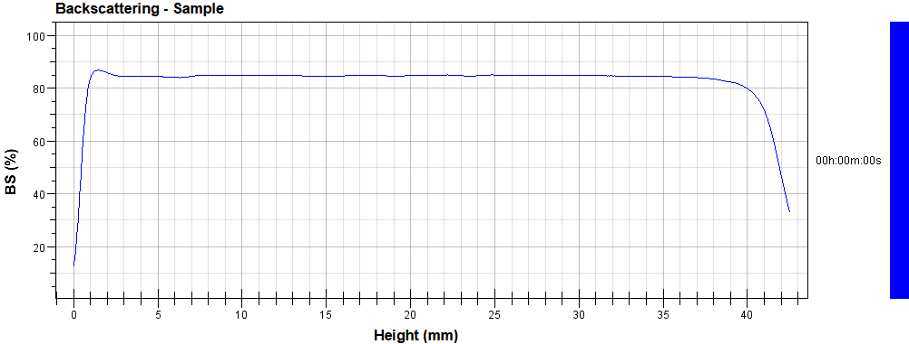

如何解读Turbiscan图谱
TURBISCAN TECHNOLOGY
初始状态
中部光强的绝对值与粒径和浓度相关
不同高度的光强波动代表均匀性
BS = 85%
BS = 85%
一次扫描
30s
$BS=\sqrt{\frac{3ϕ\left(1−g\left(d\right)\right)Q_{e}\left(d\right)}{2d}}$c
一次扫描 = 均匀性+初始分散状态
Notes:
If we start with a stable homogeneous sample, we can see that the level of backscattering or transmission is the same along the all height of the product.

Slide 15
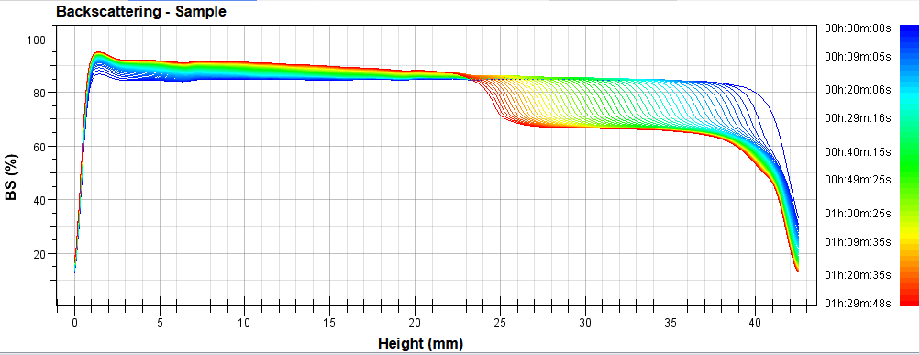
如何解读Turbiscan图谱
TURBISCAN TECHNOLOGY
随时间监测不稳定现象
沉淀
随时间
多次扫描
澄清
多次扫描, 信号变化 = 不稳定性
Notes:
If we start with a stable homogeneous sample, we can see that the level of backscattering or transmission is the same along the all height of the product.

Slide 16
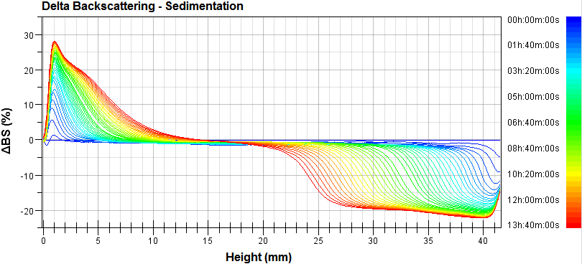
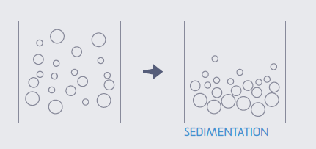
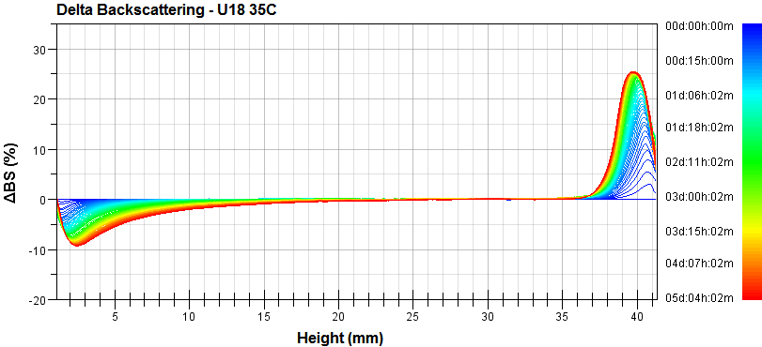
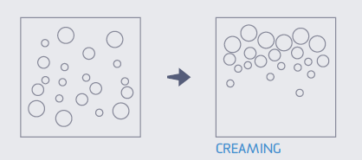
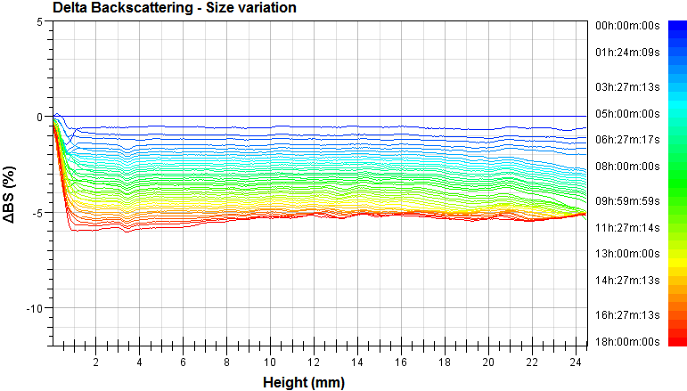
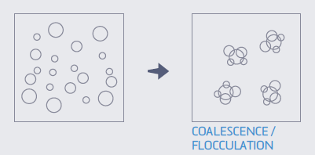
如何解读Turbiscan图谱
如何解读Turbiscan图谱
典型图谱
Identification of destabilisation mechanisms
Sedimentation
Creaming
Size variation
Notes:
If we start with a stable homogeneous sample, we can see that the level of backscattering or transmission is the same along the all height of the product.

Slide 17
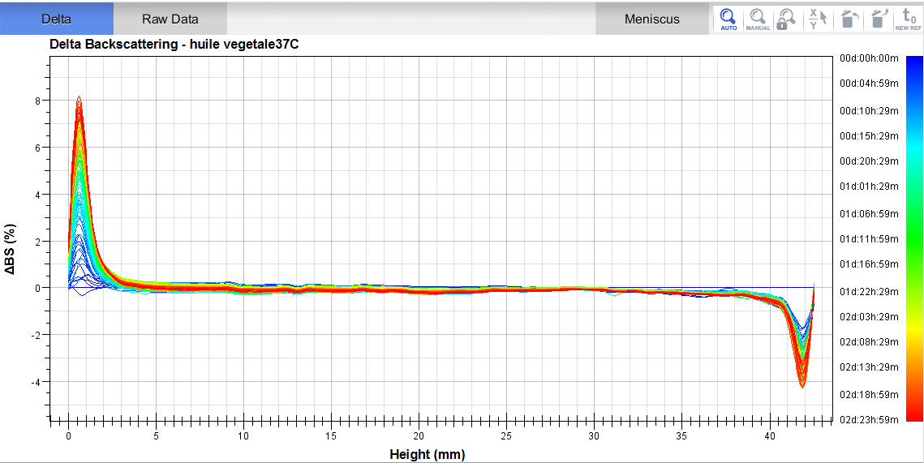
如何解读Turbiscan图谱
识别不稳定现象
将图分为三个区域
蓝色是第一条扫描线
底部
中部
顶部
红色是最后一条

Slide 18
如何解读Turbiscan图谱
典型不稳定现象
Delta BS
Bottom
Middle
Top
不稳定现象
情况 1
↑
-
↓
沉淀
情况 2
↓
-
↑
上浮
情况 3
↓ or ↑
↓ or ↑
↓ or ↑
絮凝或聚并

Slide 19
如何解读Turbiscan图谱
特殊不稳定现象
Delta BS
Bottom
Middle
Top
不稳定现象
情况 1
↓
先↑后
-
↓
沉淀+板结
情况 2
↓
-
先↑后↓
上浮+破乳
情况 3
整体倾斜
浓度梯度变化
情况 4
均匀性变差
整体波动
还有很多....

Slide 20
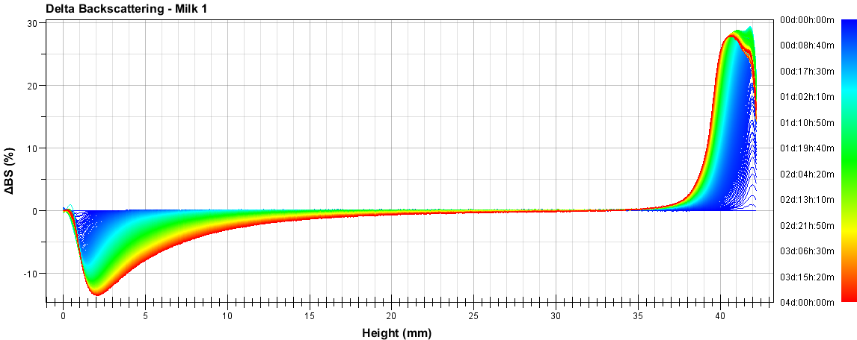
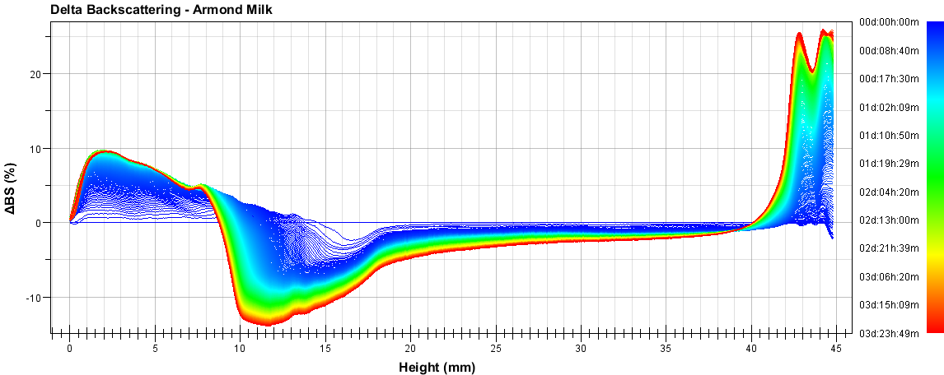
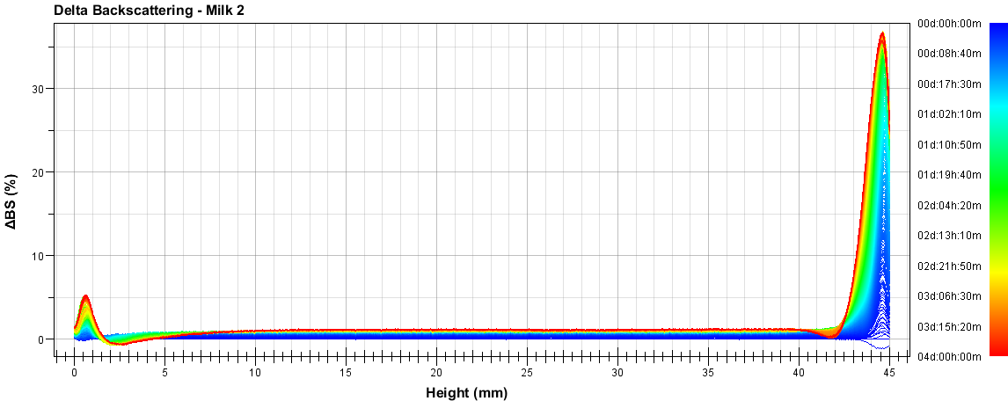
Identify problems with BS and T
Clarify Creaming
Sediment Clarify Creaming
Sediment Gelation Creaming

Slide 21
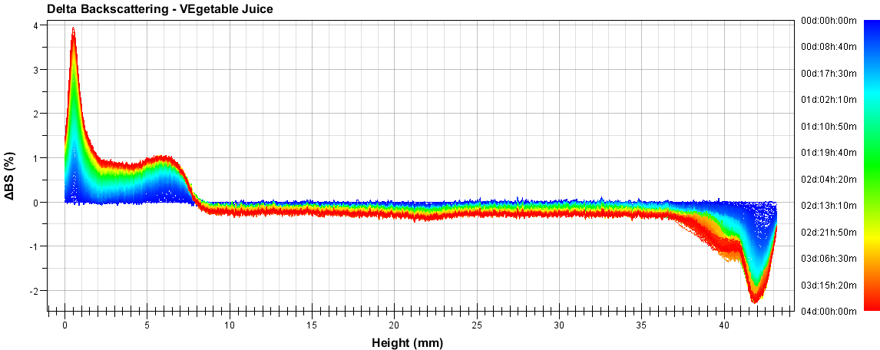
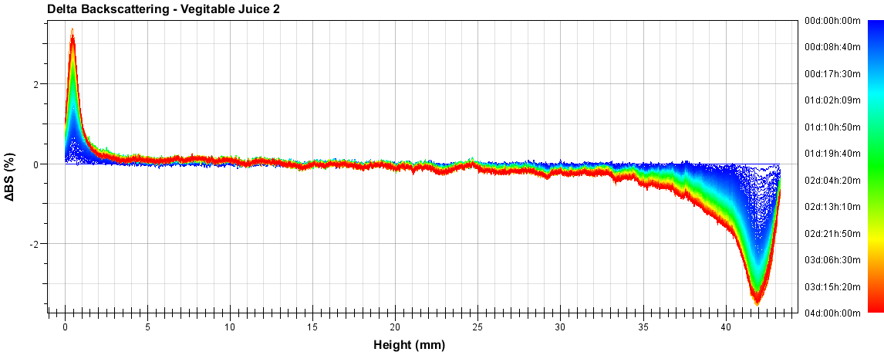
Identify problems with BS and T
Sediment Size var Clarify
Sediment Clarify

Slide 22
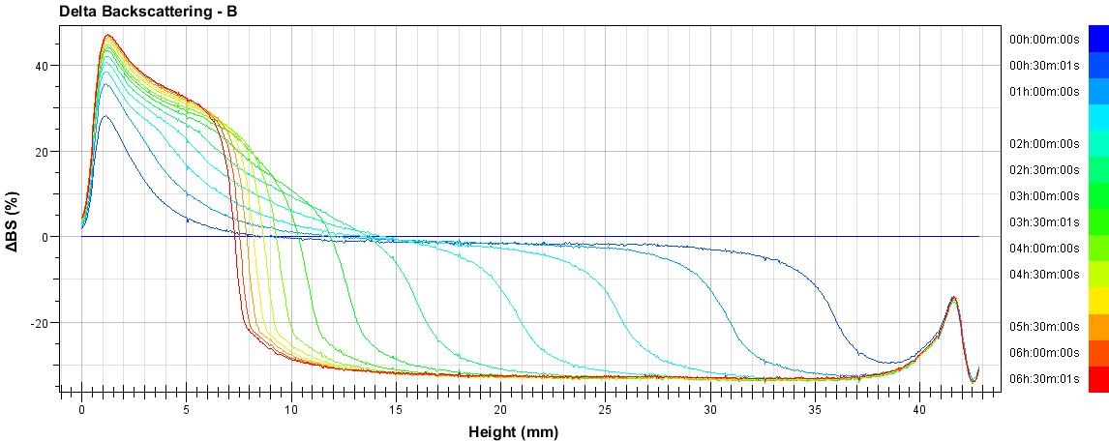
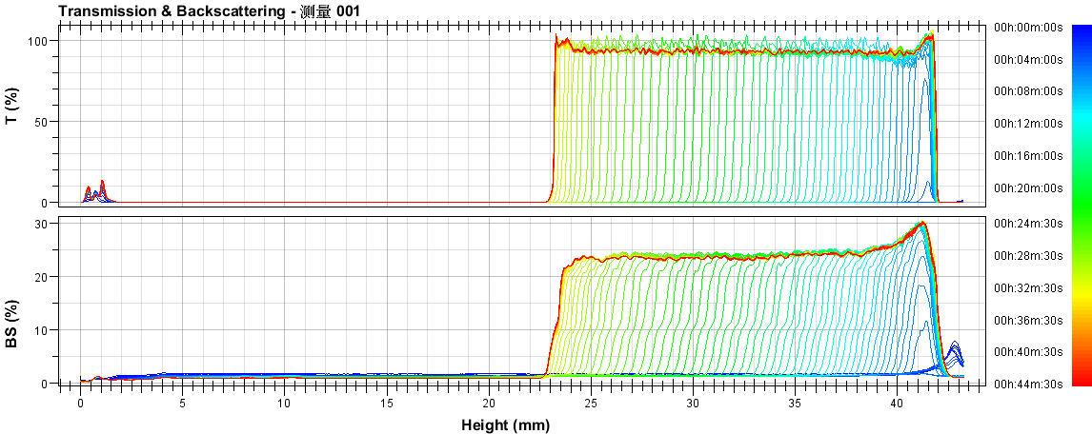
Identify problems with BS and T
Phase separation
Phase separation

Slide 23
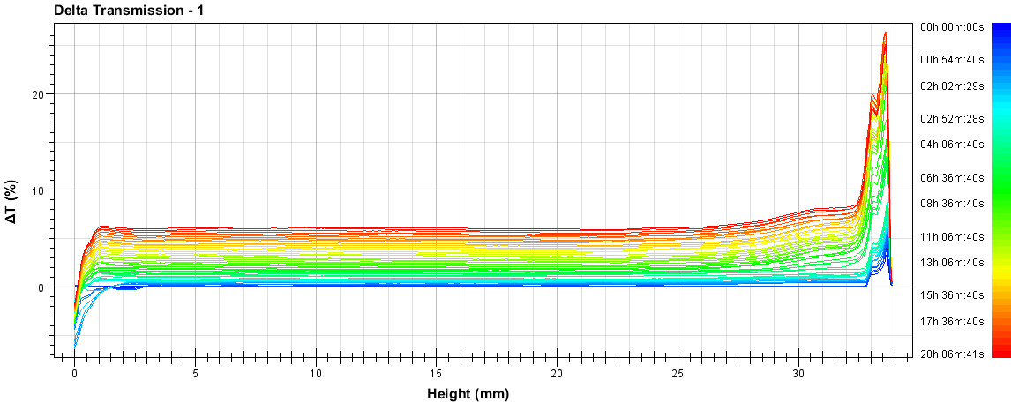
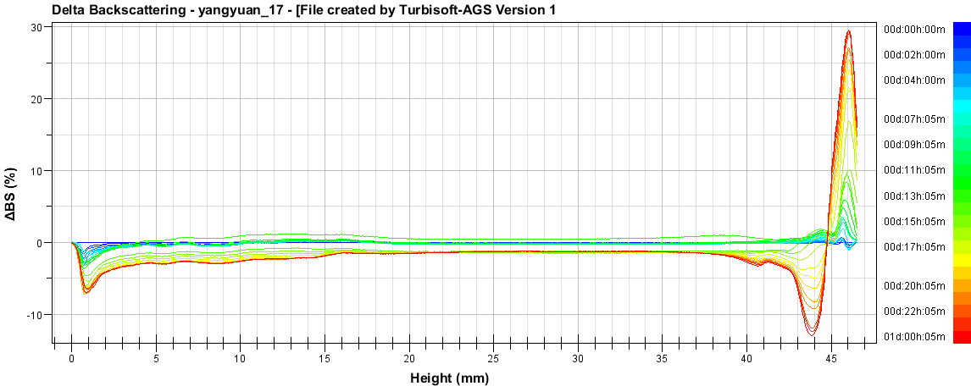
Identify problems with BS and T
Sediment Size var Clarify
Clarify Size var Clarify Creaming

Slide 24
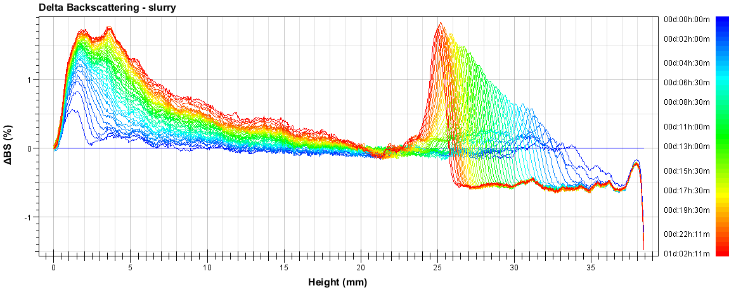
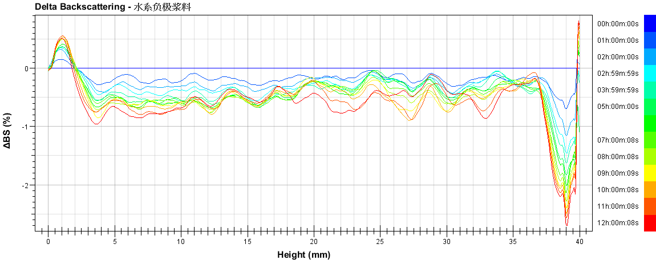
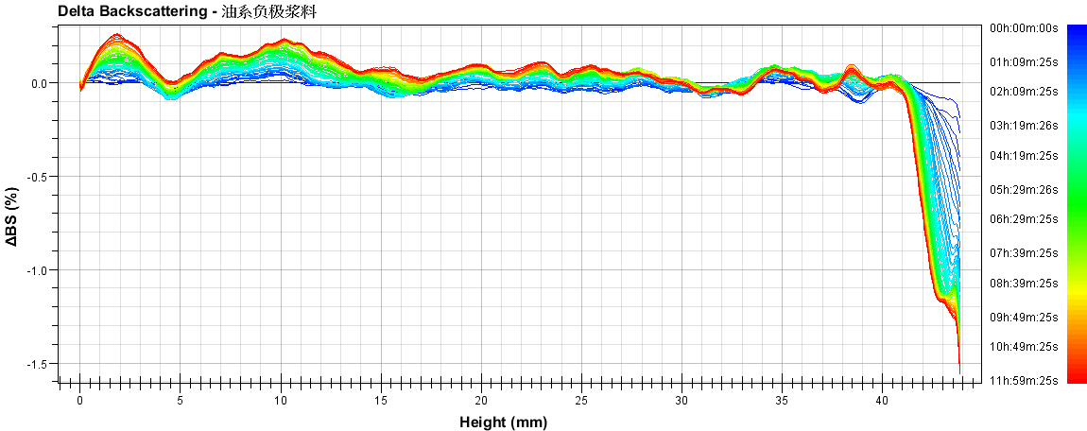
Exercise more…
Sediment1 Sediment2
Sediment Heterogeneous Clarify
Sediment Heterogeneous Clarify

Slide 25
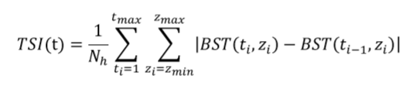
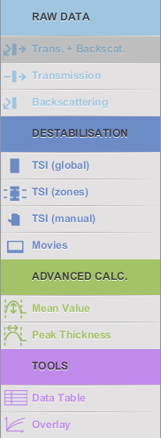
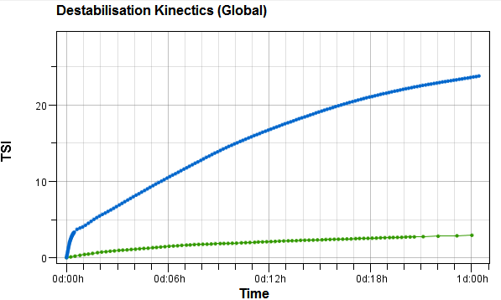
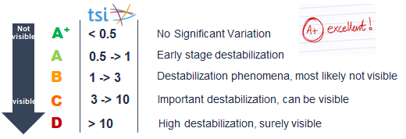
TSI稳定性指数
TSI稳定性指数
TSI 计算公式
History !
2006 :Turbiscan stability Index was introduced as a “test” with the Easysoft.
  The TSI value was well accepted by customer

Slide 26
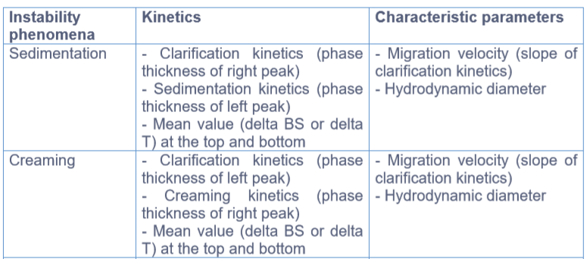
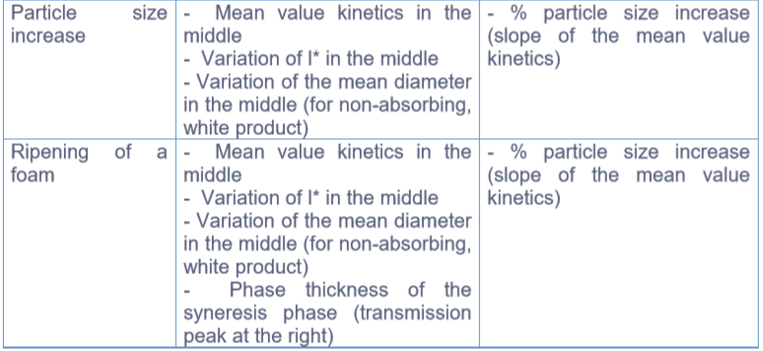
针对不稳定现象可以获得的参数
Turbiscan数据的高级计算
高级计算

Slide 27
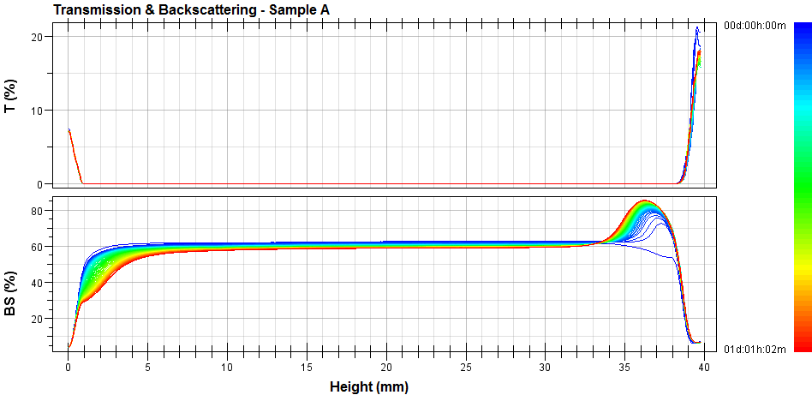
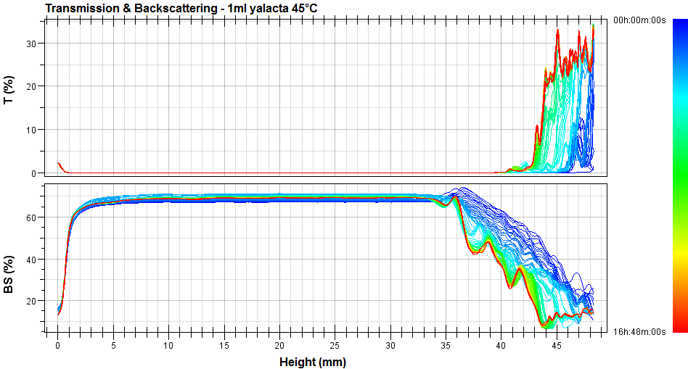
Turbiscan数据处理
Step 1 : 检查弯液面质量
所有的扫描线位置重合
弯液面区域扫描线不重合
好的弯液面质量
坏的弯液面
重要的是不要误解顶部的变化！

Slide 28
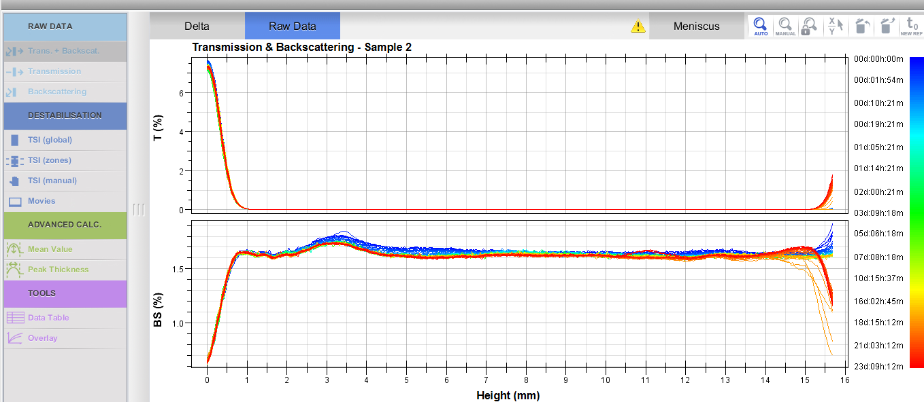

Turbiscan数据处理
Step 1 : 检查弯液面质量
软件智能提示: 如果弯液面位置不重合，则会提示黄色叹号
需要仔细解读顶部的现象，可能要更换参比线

Slide 29
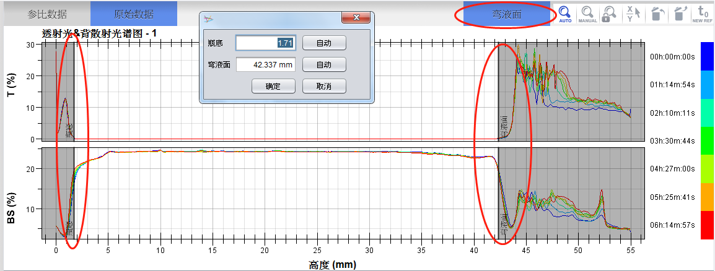
Turbiscan数据处理
Step 1 : 检查弯液面质量
点击弯液面按钮，左右拖拽，选择有效高度
需要仔细解读顶部的现象

Slide 30
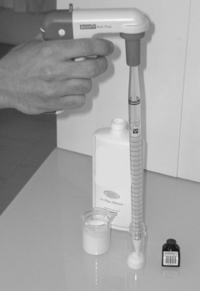
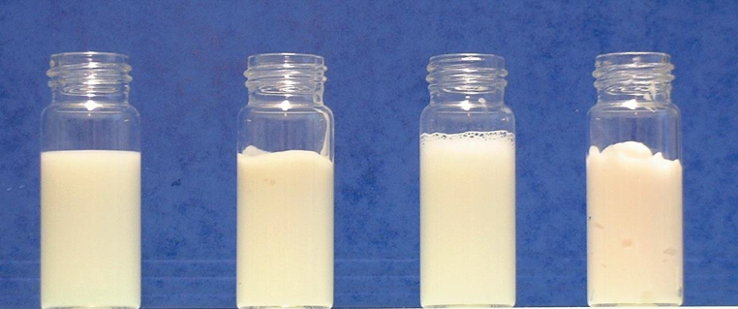
Turbiscan数据处理
Step 1 :检查弯液面质量
避免坏的弯液面 :
制样时避免顶部出现气泡
高粘度样品让顶部尽量平整
让样品在高温下平衡一段时间后再装样
高粘度样品可以用空底样品池取样
小技巧 : 注射器 + 柔性吸管或泵入系统
好的弯液面

Slide 31
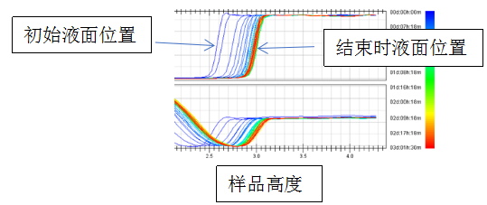
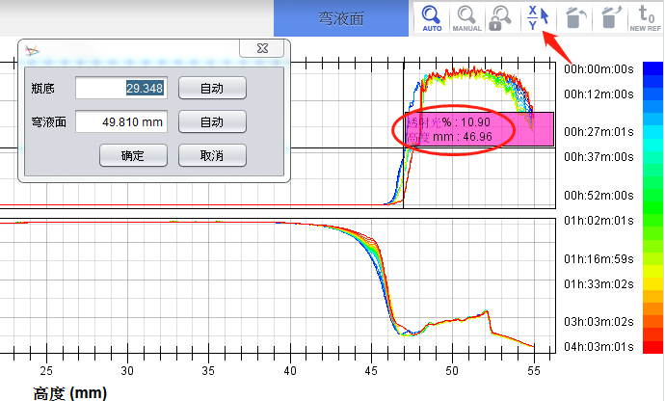
参数1 体积变化值
Turbiscan数据处理
Turbiscan数据处理
体积变化值=测试结束时液面高度-初始液面高度
如果随着测试时间延长，样品的液体空气界面随着测试时间逐渐升高，意味着样品的体积发生了膨胀，体积膨胀对稳定性一般影响不大，但是可能容易造成卡泵，造成施工困难。
体积变化一般也是工艺上的问题，当聚合物含量比较多时，胶没有完全溶胀好，没有完全水合好的时候，容易出现体积膨胀。

Slide 32

Turbiscan数据处理
Step 2 透射光 或 背散射光?

Slide 33

Turbiscan数据处理
Step 2 透射光 或 背散射光?
如果 T=0%, 则用背散射BS信号
如果T> 0.2%, 则只用透射光T信号
玻璃瓶壁反射

Slide 34
Turbiscan数据处理
Turbiscan数据处理
均匀度∝中部光强的波动
Homogeneity over the all sample height
BS = 85%
BS = 85%
First scan
30 seconds
$BS=\sqrt{\frac{3ϕ\left(1−g\left(d\right)\right)Q_{e}\left(d\right)}{2d}}$c
Single scan = Homogeneity
Notes:
If we start with a stable homogeneous sample, we can see that the level of backscattering or transmission is the same along the all height of the product.

Slide 35


Turbiscan数据处理
Turbiscan数据处理
参数2 均匀度指数
均匀度指数是取样品初始时刻10-30mm处所有背散光数据点进行相对标准偏差（RSD，relative standard deviation）的计算
excel——》STDEV.S

Slide 36
Turbiscan数据处理
参数2 均匀度指数RSD的意义
分散均匀性指数，表征了样品中各个分散组分在体系中的分散均匀性程度，指数越大，样品的分散均匀性越差。分散均匀度指数是由很多因素绝对的。如粒度分布、亲水胶的分散程度、分子量大小以及分子构型。
当样品均匀度比较差时，均匀度指数会偏大，这意味着样品制备工艺可能存在问题，例如溶胶时间不够，或者溶胶温度不够高，造成分散体系均匀性差。同样，我们也可以利用均匀度指数来帮助设定样品生产时的工艺参数，以节省能源和保证产品质量。
测量 | 均匀度指数
A | 3.61
B | 2.53
RSD越小均匀性越好

Slide 37
Turbiscan数据处理
Turbiscan数据处理
中部光强绝对值
反映粒径大小
BS = 85%
First scan
30 seconds
$BS=\sqrt{\frac{3ϕ\left(1−g\left(d\right)\right)Q_{e}\left(d\right)}{2d}}$c
Single scan = Homogeneity
Notes:
If we start with a stable homogeneous sample, we can see that the level of backscattering or transmission is the same along the all height of the product.

Slide 38


Turbiscan数据处理
Turbiscan数据处理
中部光强绝对值

Slide 39

Turbiscan数据处理
参数3 初始时刻中部BS：粒径信息
根据米氏散射方程，BS与平均粒径d和体积浓度c呈如下关系。
当几个样品浓度相近的时候，初始时刻中部BS值反映样品粒径的信息，中部BS值越大的样品平均粒径d越小；同理，中部BS越小的样品平均粒径d越小。
当我们更换不同厂家原料或者生产工艺时，如果中部BS值光强值比较小，说明样品粒径差异不大，但是当光强波动比较大的时候，就必须对这批样品进行关注。

Slide 40

Turbiscan数据处理
Step 3 : 将数据改为参比模式
更容易观察到不稳定现象

Slide 41
Turbiscan数据处理
Step 4 : 识别不稳定现象
蓝色是第一条扫描线
底部
中部
顶部
红色是最后一条

Slide 42
Turbiscan数据处理
Step 4 : 识别不稳定现象
Delta BS
Bottom
Middle
Top
不稳定现象
情况 1
↑
-
↓
沉淀
情况 2
↓
-
↑
上浮
情况 3
↓ or ↑
↓ or ↑
↓ or ↑
絮凝或聚并

Slide 43


Turbiscan数据处理
Step 5 : 评价稳定性变化
TSI不稳定性指数
ΔBS-底中顶
峰厚度

Slide 44


Turbiscan数据处理
Step 5 : 计算动力学不稳定指数
参数4 TSI
TSI 根据样品整体高度计算
TSI 根据预定区域（底中顶）计算
TSI 根据选定的高度区域计算
TSI

Slide 45


Turbiscan数据处理
ΔBS中部计算设置

Slide 46


Turbiscan数据处理
中部ΔBS值反映颗粒尺寸的变化

Slide 47
Turbiscan数据处理
参数5 中部ΔBS值：颗粒粒径的变化
中部ΔBS经验值
0-0.2%之间时，样品属于绝对稳定，基本可以满足3年的货架期。
0.2-0.5%时属于中等稳定，需要考虑运输条件，当样品漂洋过海，经历比较大的温度波动的时候，就可能出现问题。
大于0.5%时，说明样品是绝对不稳定的，无法满足3年的货架期。
中间部分的光强变化由分散剂决定，一般可以从分散剂种类和加量入手来改善问题。
在判断配方稳定性时，首先要看样品粒径是否有变化，因为粒径变化会导致沉降和上浮速度加快。当粒径变化比较小的时候，我们再来用顶部和底部的ΔBS评价沉淀和上浮程度。

Slide 48

Turbiscan数据处理
参数6 顶部和底部ΔBS

Slide 49
Turbiscan数据处理
参数6 顶部ΔBS
顶部ΔBS经验值
ΔBS＜5%，样品是绝对稳定的；
ΔBS5-8%，说明样品是中等稳定程度，遇到恶劣储存条件会出问题
ΔBS＞8%时，样品是绝对不稳定的。
通常来说，不同的分层类型有不同的评判标准，不同解决问题的方法。胶加入过少或者过多都容易引起分层。是由于颗粒在样品顶部区域浓度变化导致的，在分散体系中，一般会加入悬浮剂（胶体、增稠剂），降低颗粒的迁移速度。

Slide 50
Turbiscan数据处理
参数7 底部ΔBS
底部ΔBS经验值
ΔBS＜5%，样品是绝对稳定的；
ΔBS5-8%，说明样品是中等稳定程度，遇到恶劣储存条件会出问题
ΔBS＞8%时，样品是绝对不稳定的。
与顶部ΔBS类似，底部ΔBS是由于颗粒在样品底部区域浓度变化导致的，判断标准与顶部一样。实际上，由于原材料之间的对比度不同，视觉观察可能对分层情况有不同的感觉，这时判断标准可能要做相应的调整。

Slide 51

Turbiscan数据处理
Step 6 : 分层现象定量
上浮
澄清

Slide 52

Turbiscan数据处理
Step 6 :分层现象定量
沉淀
澄清

Slide 53


Turbiscan数据处理
Step 6 : 计算分层区域浓度变化
迁移引起的浓度变化 : 底部或顶部区域的光强平均值
Set the zone
More intense
Less intense
光强平均值曲线反映浓度变化

Slide 54


Turbiscan数据处理
Step 6 : 计算分层厚度
迁移引起的分层高度 : 底部或顶部的峰厚度
设置区域
Thicker
0,36mm/hour
0,10mm/hour
Thinner
分层厚度 / 迁移速率

Slide 55



Turbiscan数据处理

Slide 56

Turbiscan数据处理
Step 6 :分层厚度设置界面

Slide 57



Turbiscan数据处理
Step 7 : 计算粒径变化
Flocculation
Coalescence
Ostwald repining
Clarification

Slide 58


Turbiscan数据处理
Step 7 : 计算粒径变化
粒径变化 : 计算中部光强变化值
设置区域
+ 粒径变化大
- 粒径变化小
光强变化反映粒径变化

Slide 59


Turbiscan数据处理
Step 7 : 计算粒径变化
粒径变化 :
np, nf, Φ

Slide 60


数据的导出
Turbiscan数据处理
数据导出方式
1.编辑:复制图像
2.编辑: 复制数据Ctrl+C
3.文件:导出PDF报告

Slide 61

Turbiscan思维导图

Slide 62
Turbiscan数据分析和案例分享

Slide 63


Turbiscan数据处理案例1
.实验目的
分别以两个区域的 a 样品及i 样品为例，我们从透射光及背散射光，分析乳液的破乳机理。
测试方法
粒径分布
Turbiscan

Slide 64


TURBISCAN APPLICATIONS
乳液不稳定机理分析
a
i

Slide 65



Diameter
粒径分布结果
稀释的粒径数据，存在疑惑

Slide 66

TURBISCAN APPLICATIONS
乳液TSI结果
但是，TSI不适用所有情况
不稳定现象增加
5d内TSI有明显区别
当TSI与实际观察情况不符
需要利用高级计算进一步分析

Slide 67
数据处理案例1-分析破乳机理
TURBISCAN APPLICATIONS
乳液不稳定机理分析
14.42%
4.36%
迁移（分层）非常速度非常快

Slide 68





TURBISCAN APPLICATIONS
乳液不稳定机理分析
样品中部光强变化曲线
-粒径同时变化
不稳定机理

Slide 69




Turbiscan数据处理案例2
不同转速制备的乳液稳定性差别
50rpm
100rpm
150rpm
200rpm

Slide 70






TURBISCAN APPLICATIONS
不同转速制备的乳液稳定性差别---失稳过程表征

Slide 71


数据处理案例2-不同转速小试
Turbiscan数据处理案例3
TURBISCAN
Formulation - Dispersibility
  Dispersibility
Dispersion : Membrane application
  Membrane is a separation layer with selective pores. Selection can be done upon particle size, chemical affinity, state (gas/liquid)…
  Process : Phase inversion via precipitation

Slide 72




TURBISCAN
Formulation - Dispersibility
  Dispersibility
Dispersion : Membrane application
  Membrane is a separation layer with selected porous. Selection can be done upon particle size, chemical affinity, state (gas/liquid)…
  Wide application
Membrane
Filtration CO2 Combustion
Water filtration
  Major issues : fouling and clogging of the membranes
  Possible solution :
  Change membrane affinity to increase anti-fouling properties

Slide 73


TURBISCAN
Formulation - Dispersibility
  Dispersibility
Dispersion : Membrane application
  TSI inside
Application
Membrane
Aim
Avoid membrane fouling/Clogging for longer shelf life
How
Add polymer into membrane matrix Problem of polymer compatibility dispersibility and stability issues
Reference
Jie Zhang, Zhiwei Wang, Qiaoying Wang, Jinxing Ma, Jing Cao, Weijie Hu and Zhichao Wu, Relationship between polymers compatibility and casting solution stability in fabricating PVDF/PVA membranes, Journal of Membrane Science Tongji University , P.R China

Slide 74

TURBISCAN
Formulation - Dispersibility
  Dispersibility
Dispersion : Membrane application
  Membrane : Matrix based on Polyvinylidene Fluoride (PVDF) + Poly(vinyl alcohol) (PVA)
  [PVA] from 0 to 4%
  Conventional method to study polymer compatibility : Enthalpy of mixing ΔH （溶体的混合焓Gibbs软件可以计算，软件要上手，很难）
Compatibility limit
ΔH < 10
ΔH is kind of complex and tedious to determine (calorimetry)
Enthapy of mixing ΔH

Slide 75

TURBISCAN
Formulation - Dispersibility
  Dispersibility
Dispersion : Membrane application
  Membrane : Polyvinylidene Fluoride (PVDF) + Poly(vinyl alcohol) (PVA) as additive
  [PVA] from 0 to 4%
  Turbiscan study for about 5 hours. TSI results
Increase [PVA]
Correlation with ΔH
TSI_{compatibility} = 4.3

Slide 76

TURBISCAN
Formulation - Dispersibility
  Dispersibility
Dispersion : Membrane application
  Membrane : Polyvinylidene Fluoride (PVDF) + Poly(vinyl alcohol) (PVA) as additive
  [PVA] from 0 to 4%
  Turbiscan study for about 5 hours. TSI results
  Thanks to TSI study based on 5 hours measurement
  => Determine polymer compatibility

Slide 77


Turbiscan数据处理案例4
Electrodes (Cathode, Anode)
Turbiscan applications
New energy – lithium ion batteries (LIBS)
  Electrode coating slurries are complex systems, which contain a large percent of solid particles of different chemicals, sizes and shaples in highly viscous media.
 | Negative electrode | Postive electrode
Active material | LiCoO₂, LiNiO₂, LiFePO_{4,} etc. | Carbon, Graphite (C6)
Electrolyte | Carbon black
Blinder | PVDF etc.
Solvent (aqueous/organic) | NMP, LiPF6, LiClO4 etc.
Hellwig, C. A. (2013). Modeling, simulation and experimental investigation of the thermal and electrochemical behavior of a LiFePO4-based lithium-ion battery.

Slide 78




Electrodes (Cathode, Anode)
Turbiscan applications
New energy – lithium ion batteries (LIBS)
  Two main technical branches that Formulaction are involved:
  Slurry Mixing Coating on substrat

Slide 79


Turbiscan applications
New energy – lithium ion batteries (LIBS)
  What can Turbiscan® do?
  To ensure the homogeneity of cathode slurry and anode slurry:
  BS value is uniform for different heights,
Effects of Adding HPC to Si-Alloy Anode Slurry of Lithium Secondary Battery

Slide 80





TURBISCAN
Basics of technology
The Reference stability analyzer
The new reference, 6 times better
High throughput stability analyzer
Turbiscan Classic
Turbiscan Lab
Turbiscan Tower
Turbiscan AGS
主要定性表征：
分层厚度
粒径大小
可定量表征：
稳定性指数
分散均一性指数
不具有稳定控制功能
一个自动测量位，
具有手动测量功能
可定量表征：
分层厚度
粒径大小
稳定性指数
分散均一性指数
温控范围RT+5℃-60℃
一个自动测量位
具有手动测量功能
可定量表征：
分层厚度
粒径大小
稳定性指数
分散均一性指数
温控范围4℃-80℃
六个自动测量位
具有手动测量功能
可定量表征：
分层厚度
粒径大小
稳定性指数
分散均一性指数
温控范围RT+5℃-60℃
54个自动测量位
具有动测量功能

Slide 81

联系我们
服务热线：4008210778
售前咨询：ins.cn@dksh.com
售后服务：ins-service.cn@dksh.com
大昌华嘉仪器部服务号
最新应用
最新活动
培训申请
DKSH (Shanghai) Co.
Technology Business Unit
Unit 605-607, Build 2, Xinglian Tower, No.1535 Hongmei Road, Shanghai, P.R.C. 200233
www.dksh.com

Slide 82
Disclaimer
Due care has been used in preparation of this presentation and DKSH makes every effort to provide accurate and up-to-date information. Nevertheless, this presentation may be subject to technical inaccuracies, information that is not up-to-date or typographical errors. DKSH does not assume liability for relevance, accuracy and completeness of the information provided. DKSH reserves the right to change, supplement, or delete some or all of the information on this presentation without notice.
The layout, graphics and other contents in this presentation are protected by copyright law and should not be reproduced or used without DKSH’s written permission.

