Slide 1
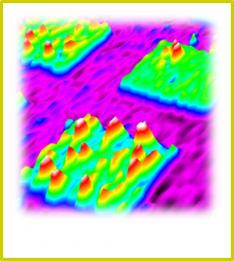
Introduction to Imaging Ellipsometry
Fangqing ZUO
Accurion China, Shanghai

Slide 2
Ellipsometry - Introduction
www.accurion.com

Slide 3
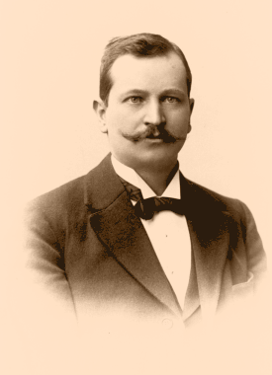
History……
Karl Ludwig Paul Drude, physicist (1863 - 1906)
( Paul Drude, Lehrbuch der Optik, Leipzig, 1900 )

Slide 4
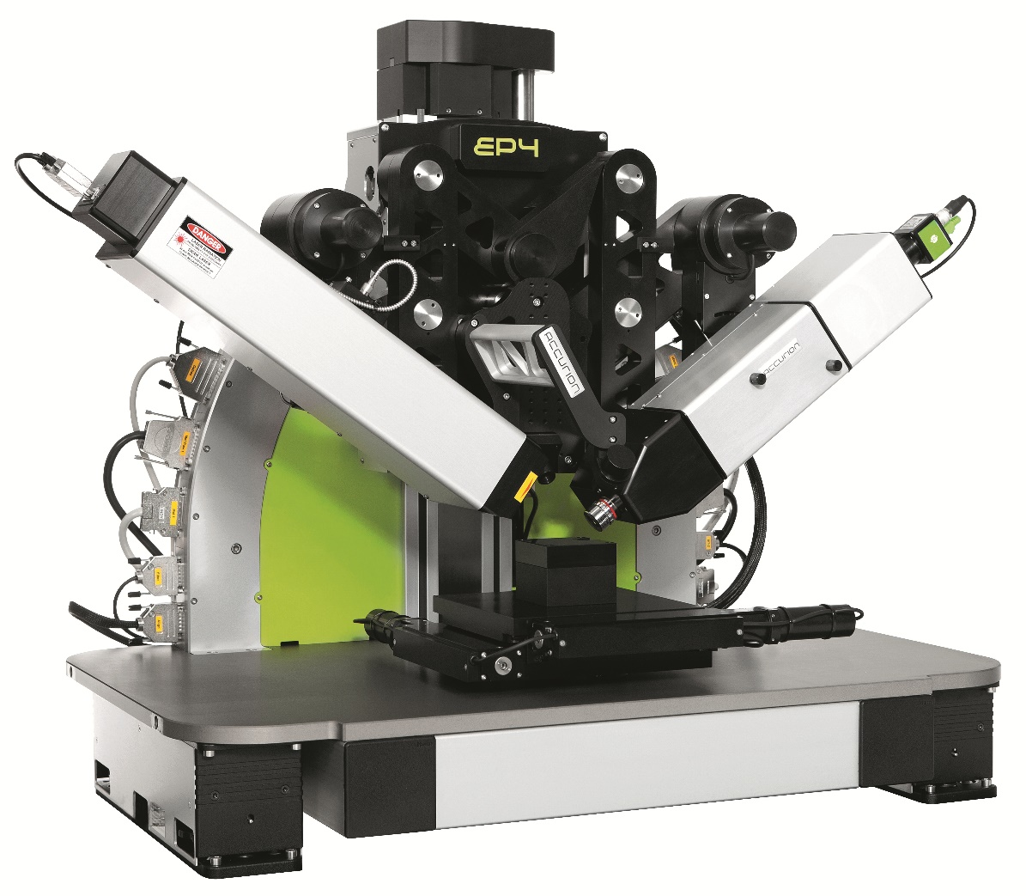
( Paul Drude, Lehrbuch der Optik, Leipzig, 1900 )
( Nanofilm_EP4, Accurion GmbH, Goettingen, 2013)

Slide 5
p
p
E
incident beam
E
s
s
film / substrate system
( Paul Drude, Lehrbuch der Optik, Leipzig, 1900 )
plane of
incidence

Slide 6

Ligth source
detector
polarizer
analyser
compensator
sample

Slide 7
P
A
p
p
s
Ligth source
detector
polarizer
analyser
compensator
sample
Nulling ellipsometry

Slide 8

NULLING ELLIPSOMETRY
measurement
Δ , Ψ
If c = 45°:
Δ = 2p + π/2 (polarizer angle at minimum signal)
Ψ = |a| (analyzer angle at minimum signal)

Slide 9
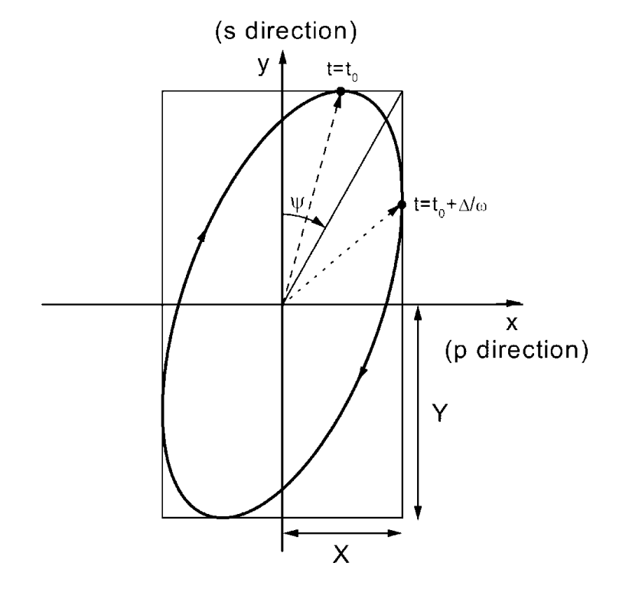

Measure Δ and Ψ

Slide 10
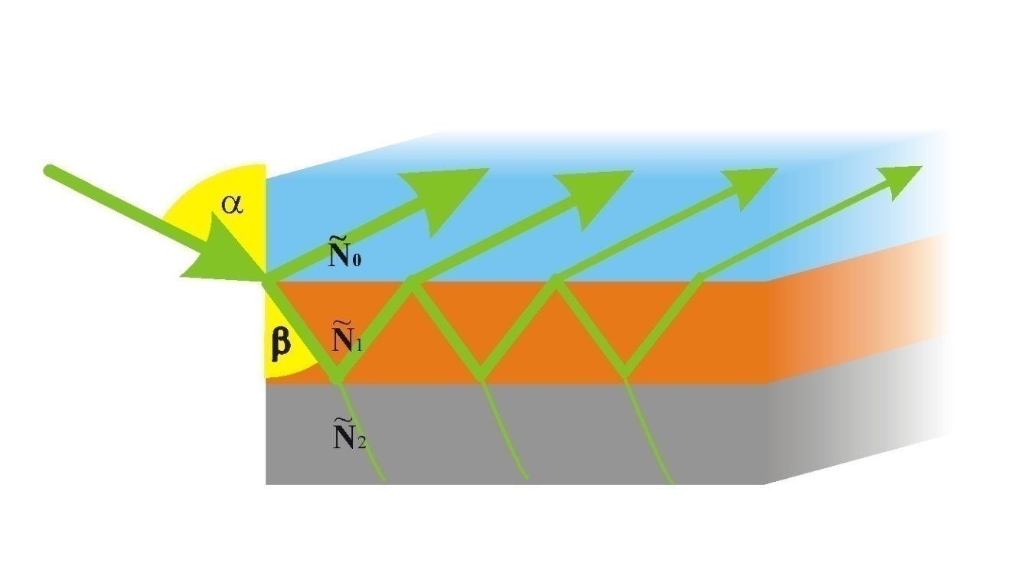
Drude equation

Slide 11
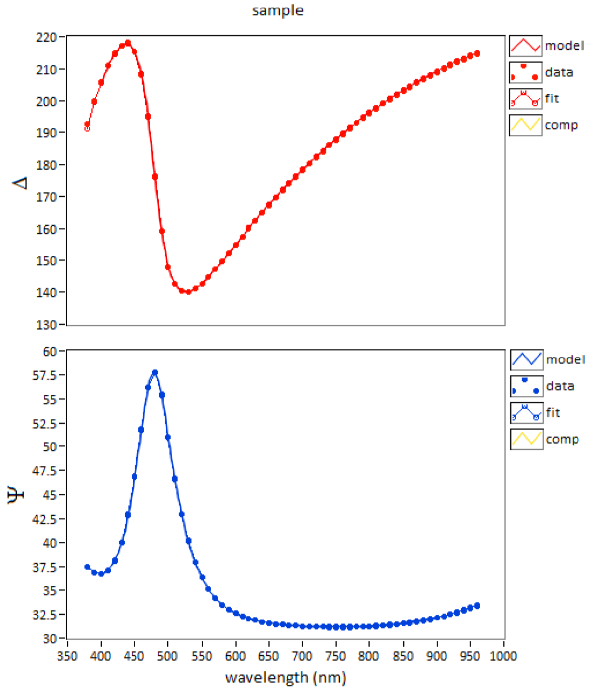
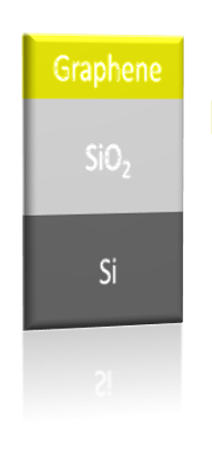
Wavelength or AOI spectra
Optical model
Results
thickness
n, k at different wavelength
volume fraction
(EMA)

Slide 12

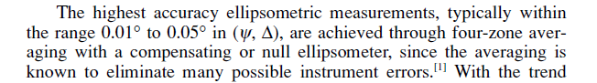
analyser

Slide 13
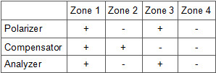
analyser
highest accuracy
eliminate system errors
full range without blind zone

Slide 14
Imaging Ellipsometry - Introduction
www.accurion.com

Slide 15
Ligth source
detector
polarizer
analyser
compensator
sample

Slide 16
Ligth source
CCD
polarizer
analyser
compensator
objective
sample

Slide 17
P
A
p
p
s
Nulling ellipsometry

Slide 18
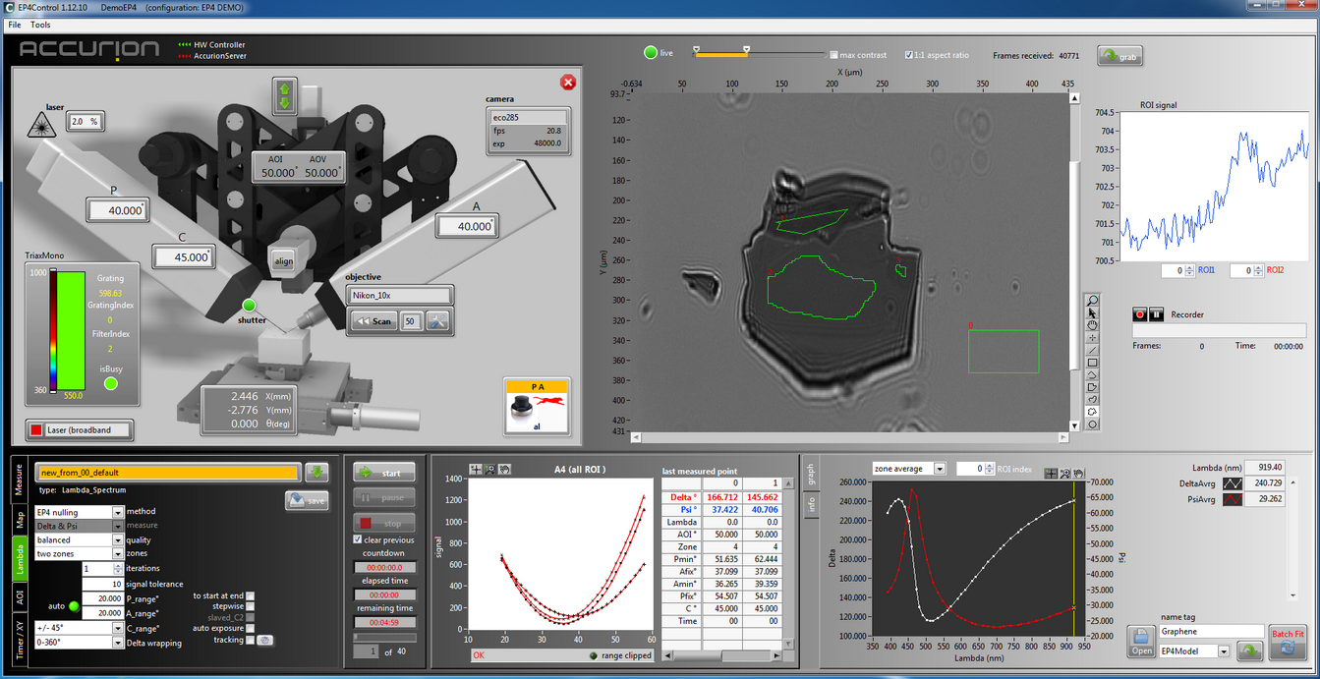

Slide 19
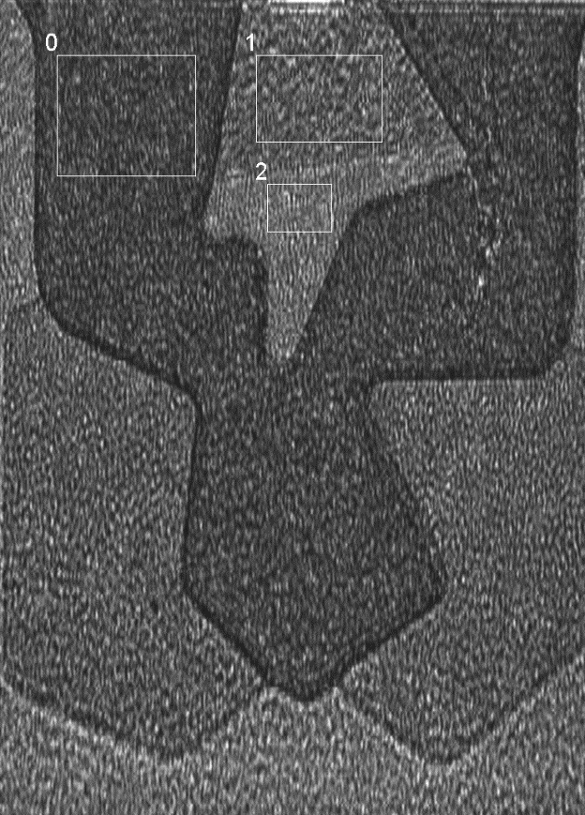
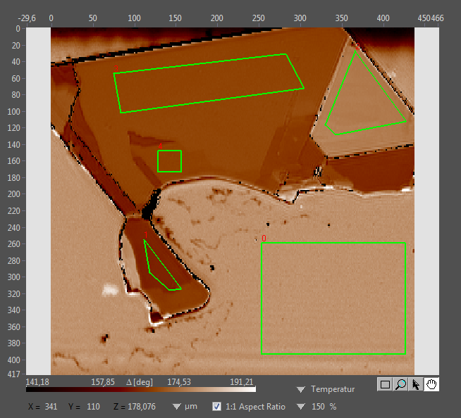
Regions of interest (ROI)
FePS3 flake

Slide 20
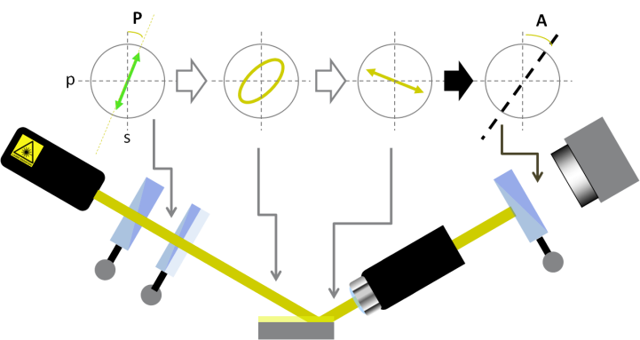
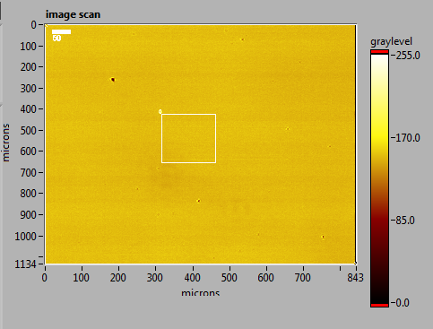
Ellipsometric Enhanced Contrast Micrographs
Air|Fe|SiO_{2(native)}|Si
0°
0°
0°
polarizer
analysator
compensator

Slide 21
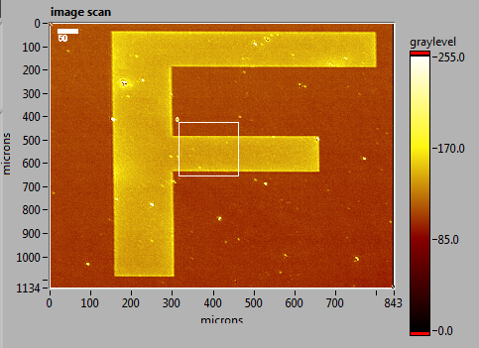
Ellipsometric Enhanced Contrast Micrographs
Air|Fe|SiO_{2(native)}|Si
45°
45°
45°
polarizer
analysator
compensator

Slide 22
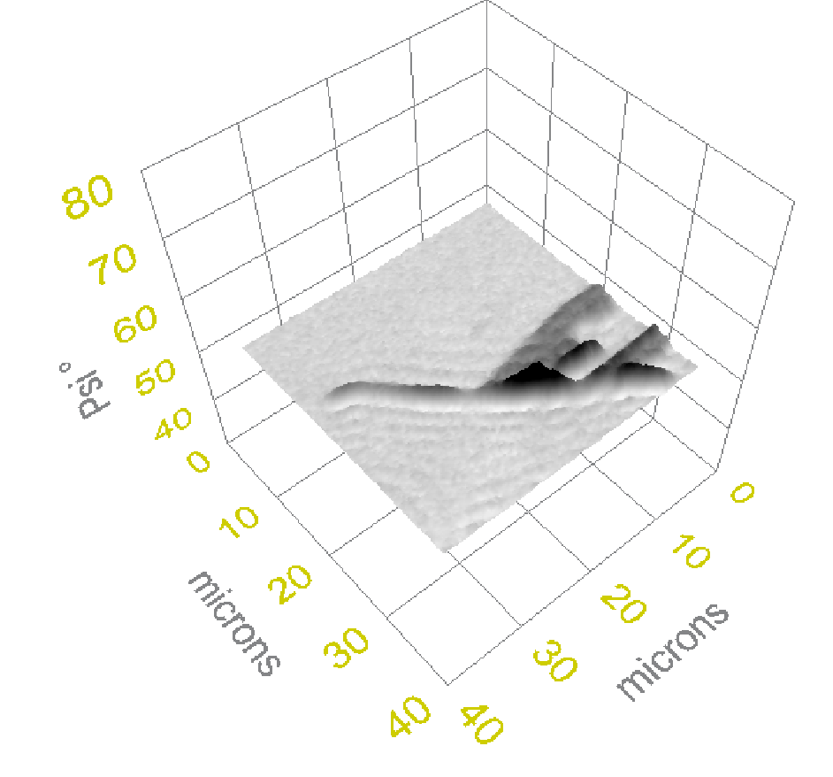
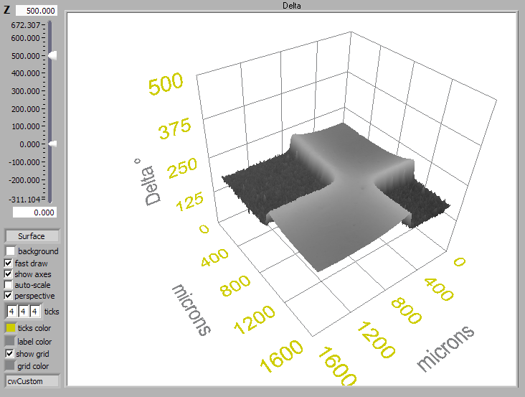
Microscopic mapping
Delta-map Psi-map

Slide 23
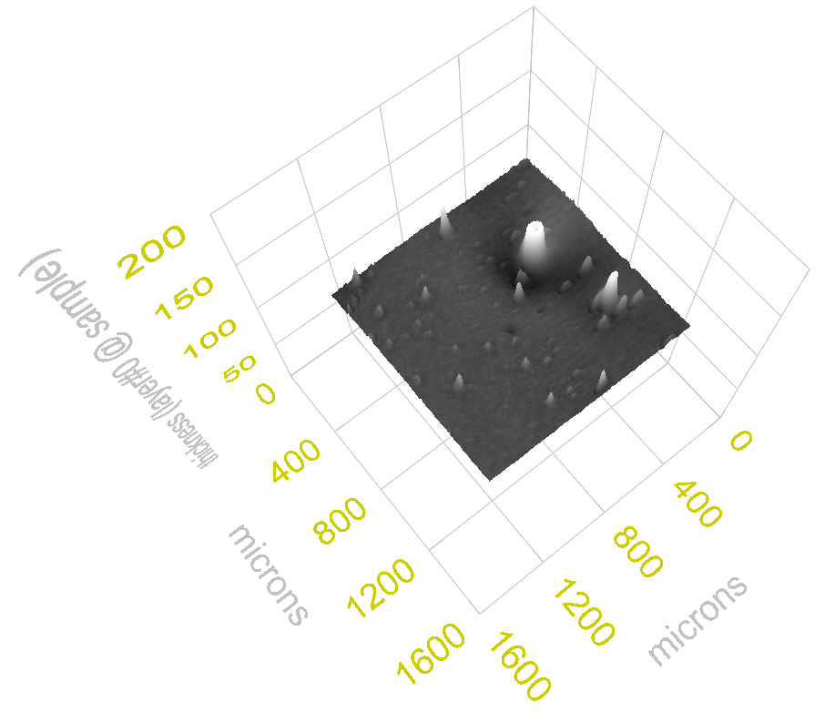
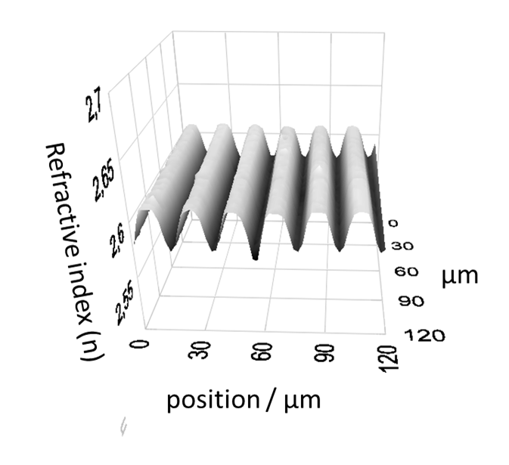
Microscopic mapping
Thickness map refractive index map

Slide 24
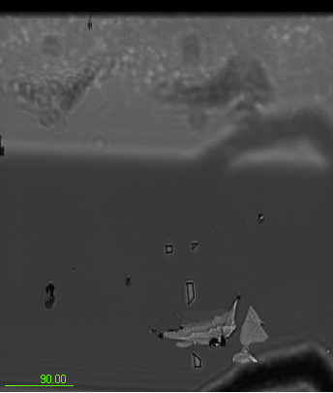
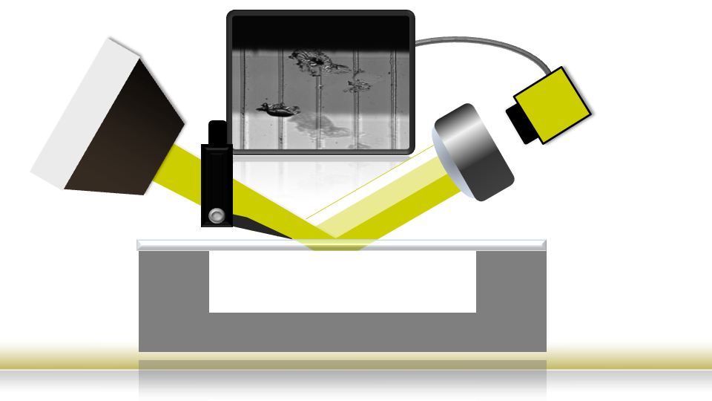
Eliminate back-reflection
Air|MoS2|Sapphire

Slide 25
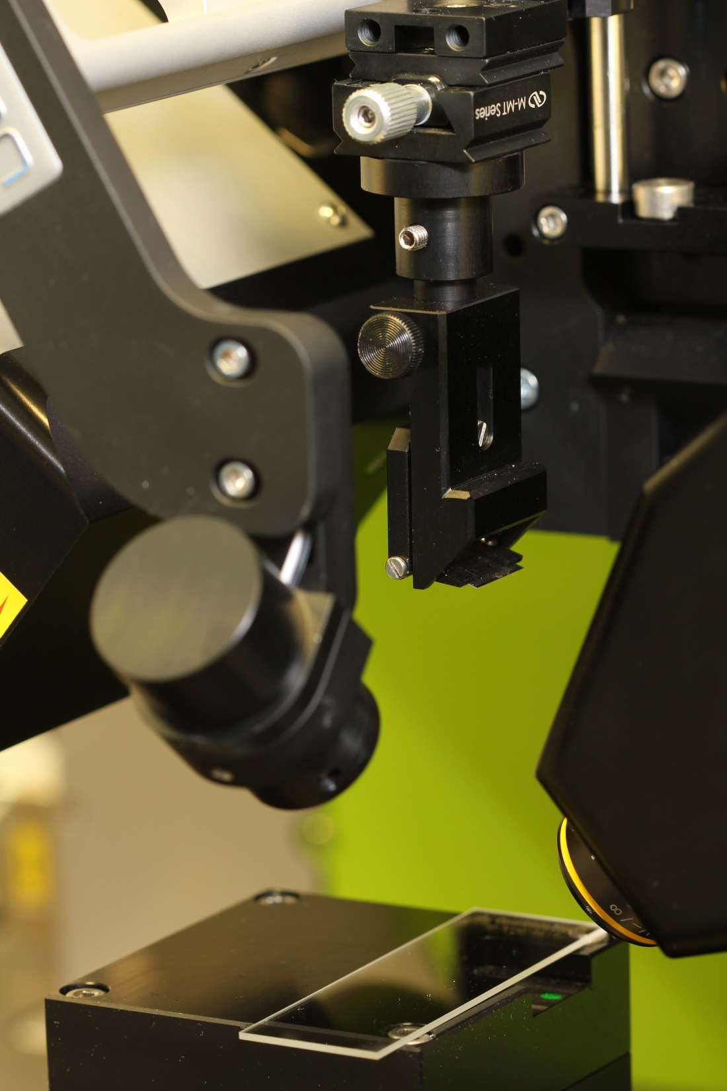
Eliminate back-reflection
Air|MoS2|Sapphire

Slide 26
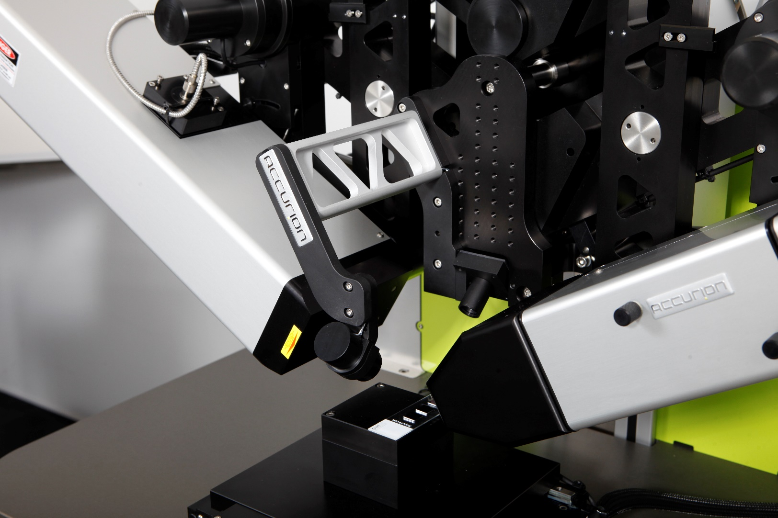
11
EP4_alignment_sensor:
Accurion has two sub

Slide 27
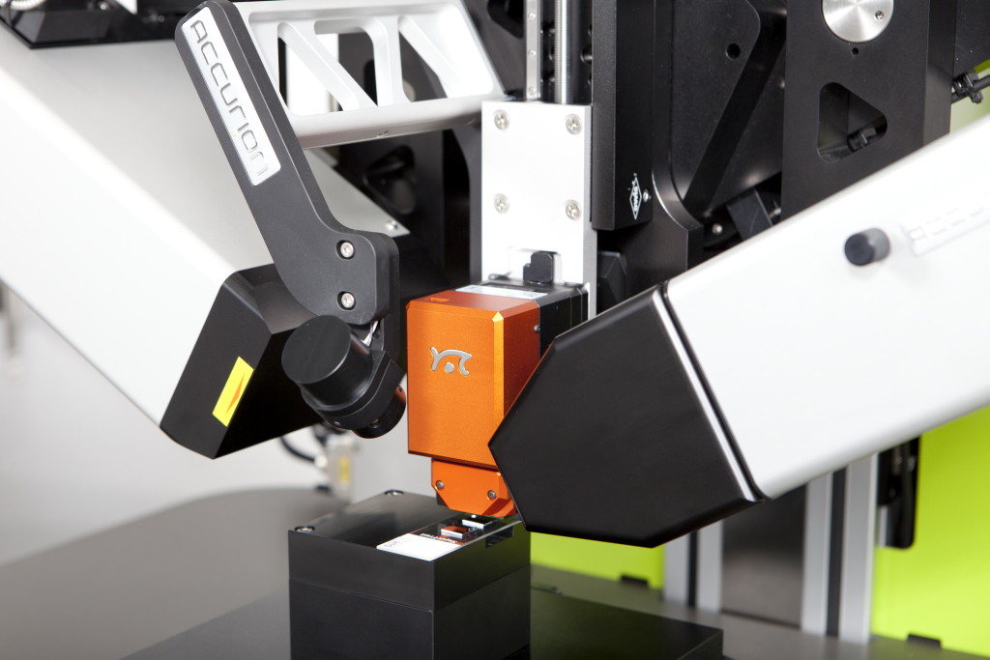
11
AFM NaniteB (Nanosurf):
Automatic linear stage
Compact multi-purpose AFM
Accurion has two sub

Slide 28
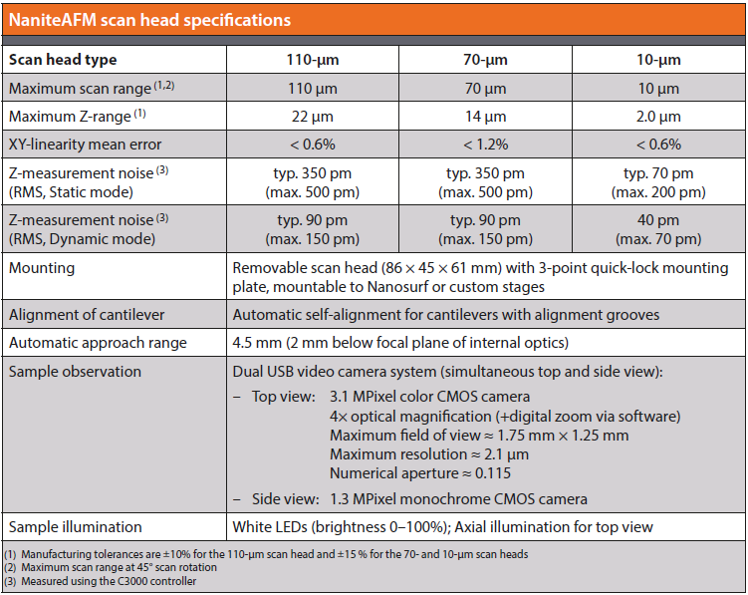
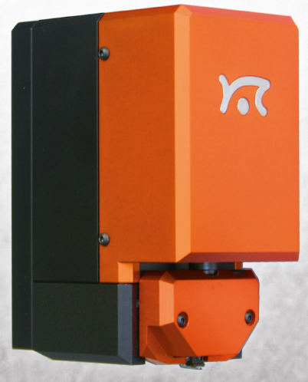
12
AFM NaniteB (Nanosurf):
Accurion has two sub

Slide 29
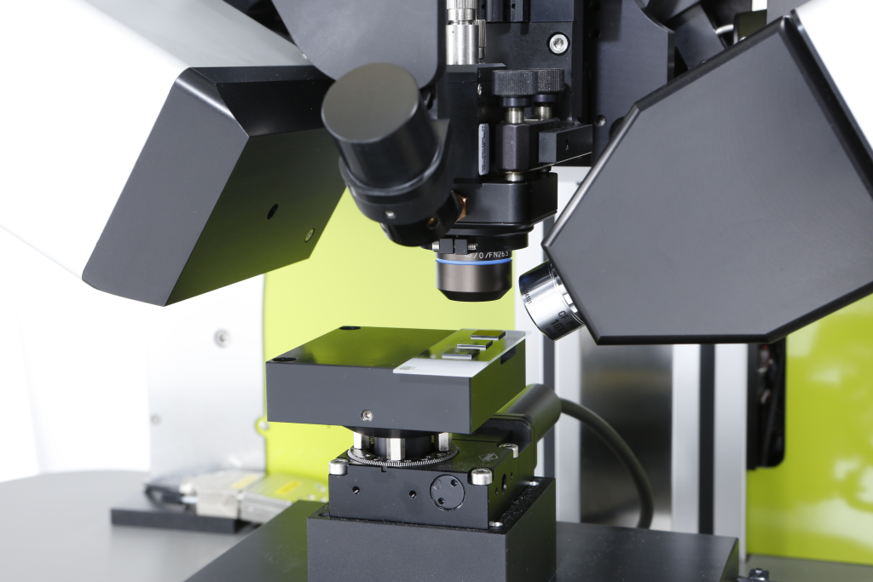
14
MicroRaman System (Horiba):
Automatic linear stage
Compact Raman probe
Multi-axis alignment
Microspot objective
Accurion has two sub

Slide 30
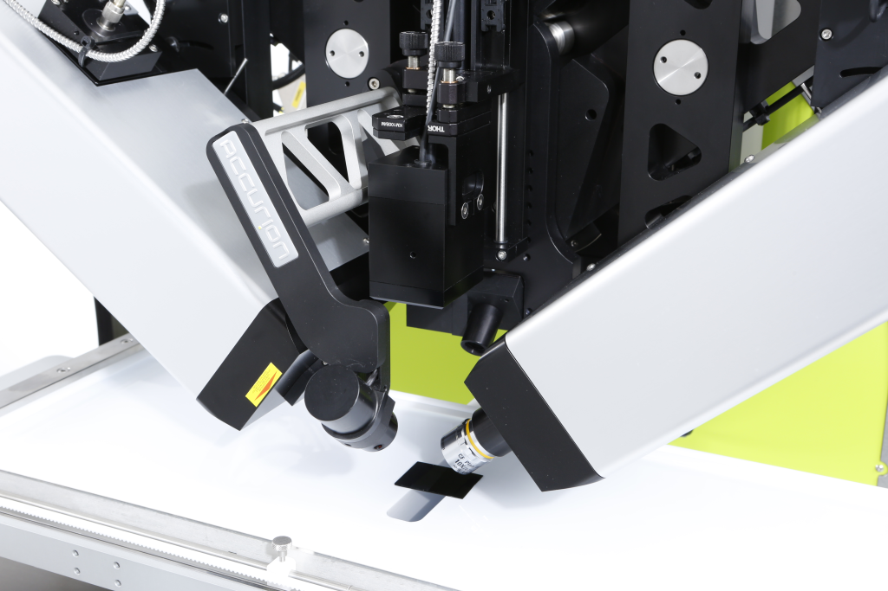
17
UV / VIS Reflection Spectrometer RefSpec (Accurion):
Automatic linear stage
Multi-axis alignment
Compact sensor head
Accurion has two sub

Slide 31
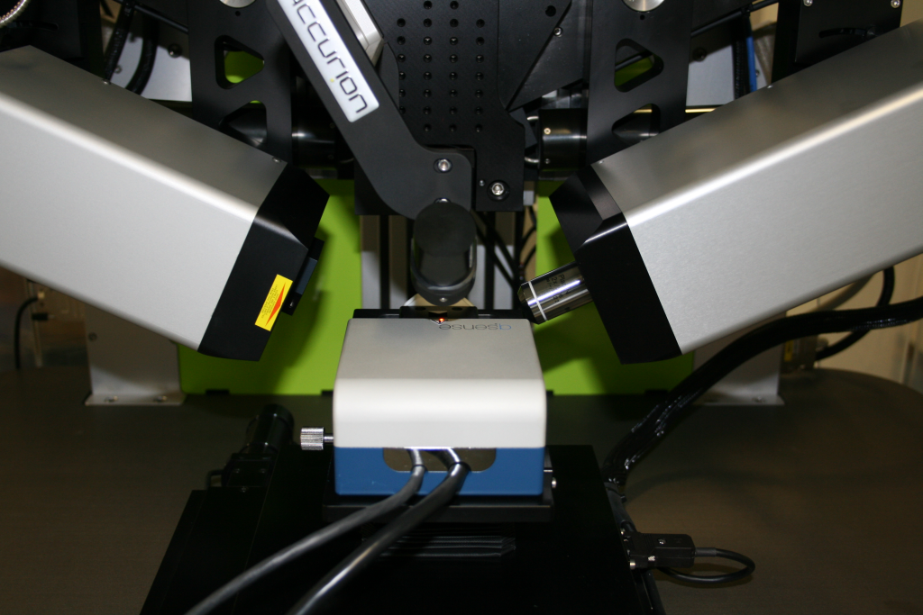
20
QCM-D system E1 (Q-Sense):
Accurion has two sub

Slide 32
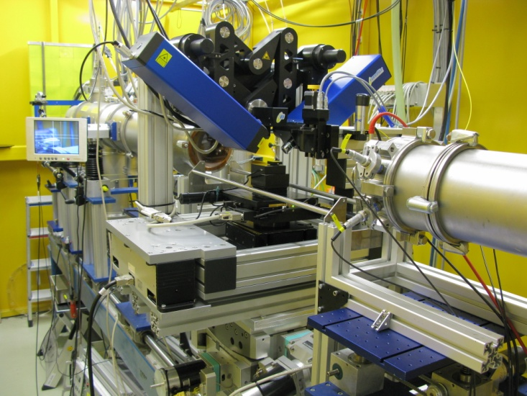
24
Electron synchrotron DESY (Hamburg, Germany):
V. Körstgens et al. (2010)
Combining imaging ellipsometry and grazing incidence small angle X-ray scattering for in situ characterization of polymer nanostructures.
Anal Bioanal Chem., 396 , 139-149
Accurion has two sub

Slide 33
Imaging Ellipsometry - Application
www.accurion.com

Slide 34
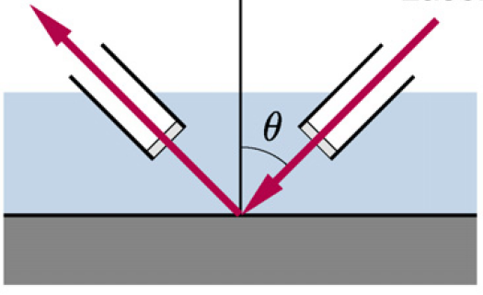
Applications
Light guides for Liquid-Liquid interfaces
L1
L2
Glass pipes inmersed in the upper liquid act as light guide for the beam, avoiding the air-liquid interface and so the undesired displacements of the beam path

Slide 35
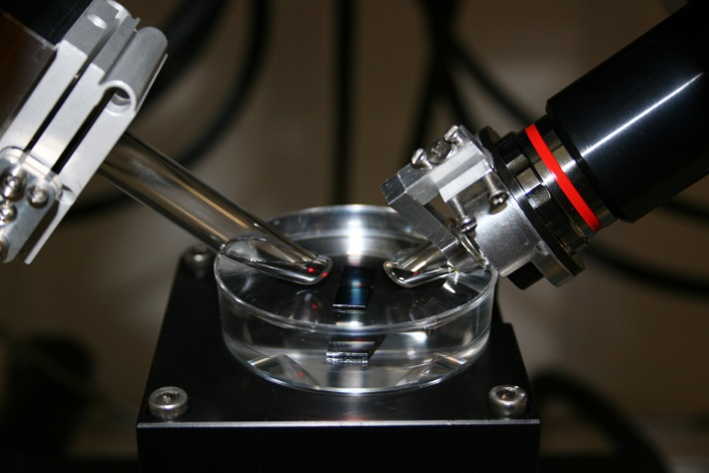
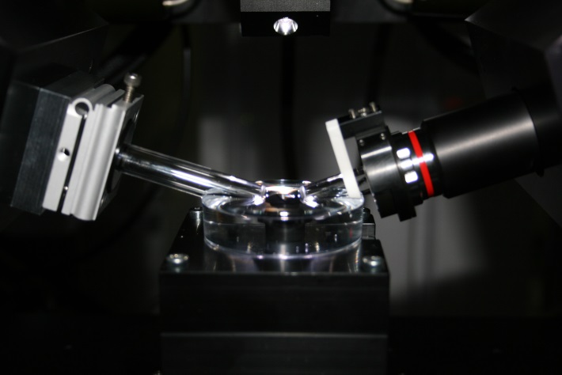
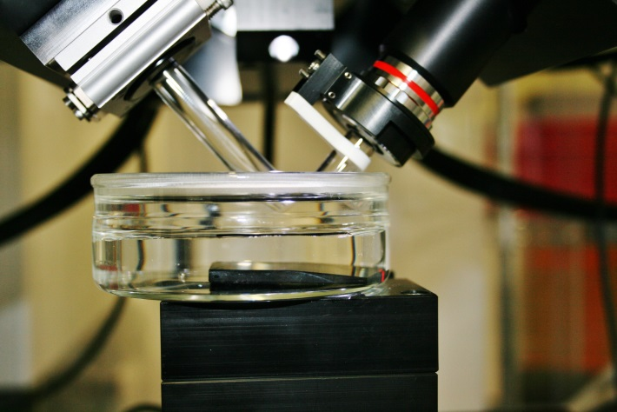
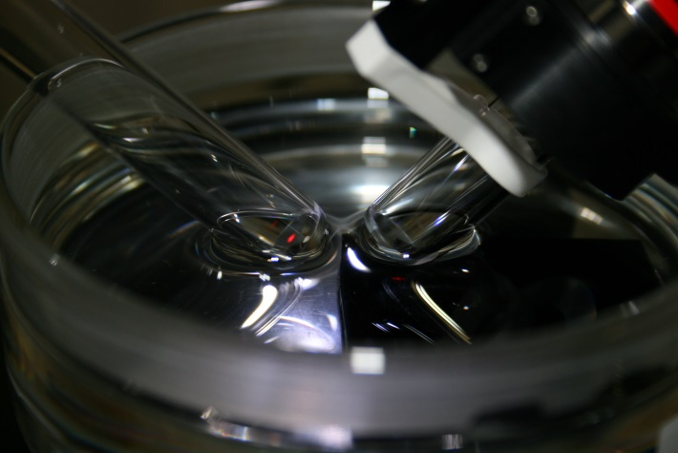
Applications
Light guides for Liquid-Liquid interfaces

Slide 36
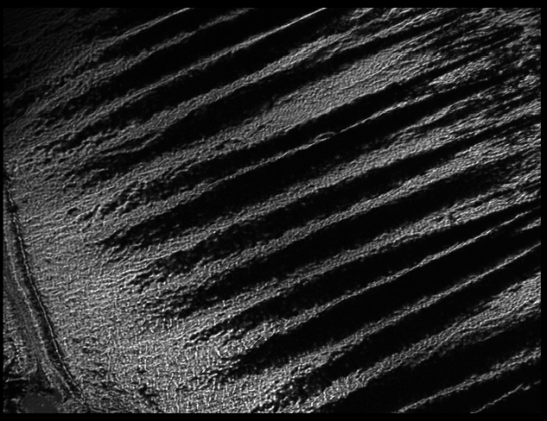
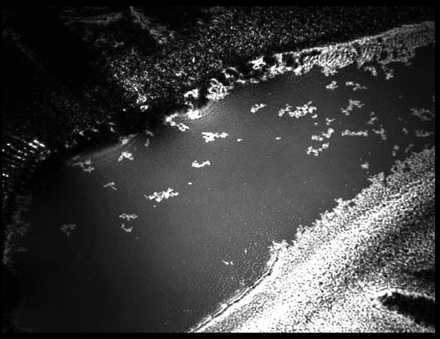
Applications
Light guides for Liquid-Liquid interfaces
Polystyrene at parafin oil-water interface

Slide 37
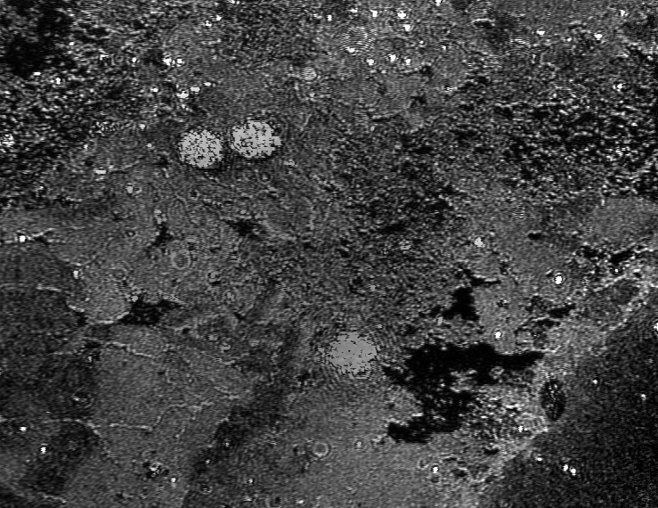
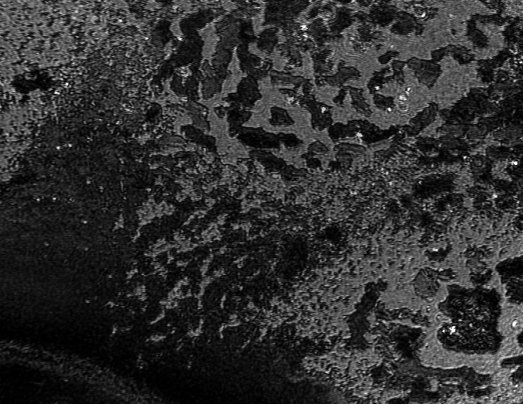
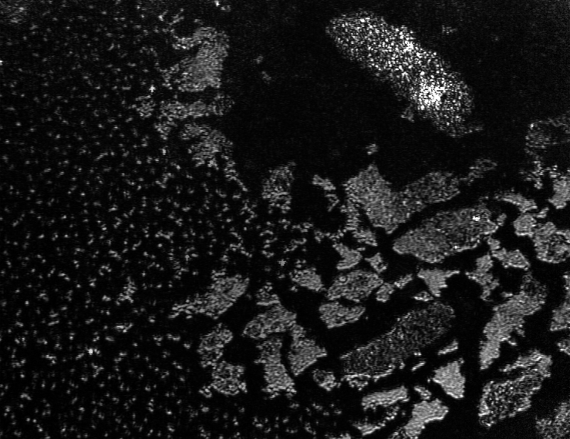
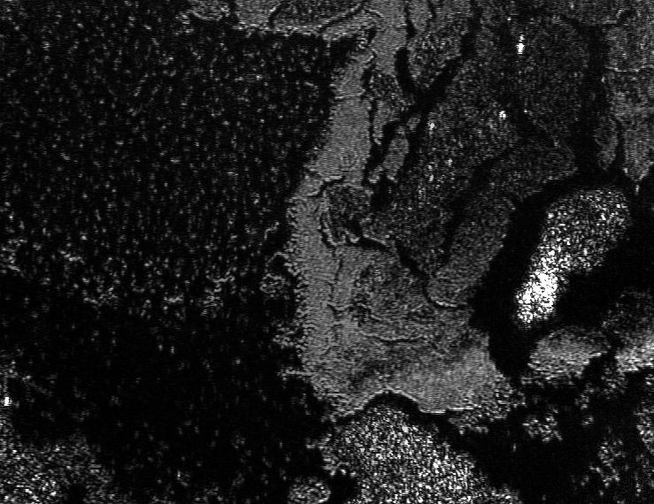
Applications
Light guides for Liquid-Liquid interfaces
Cetylpyridiniumbromide at the toluene-water interface

Slide 38
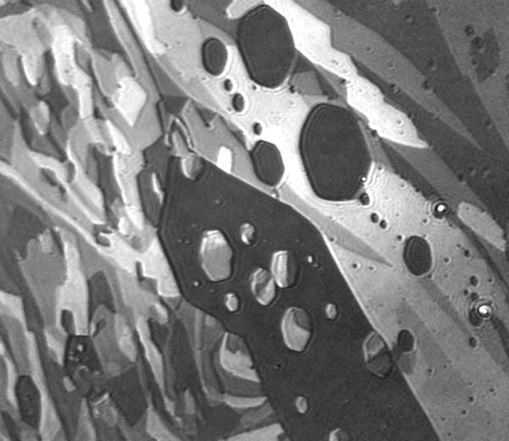
Applications
Air-Liquid interfaces – BAM pictures
DMPE
Sphingomyelin
Ethyl stearate
Notes:
I have organised my talk in the following steps
38

Slide 39
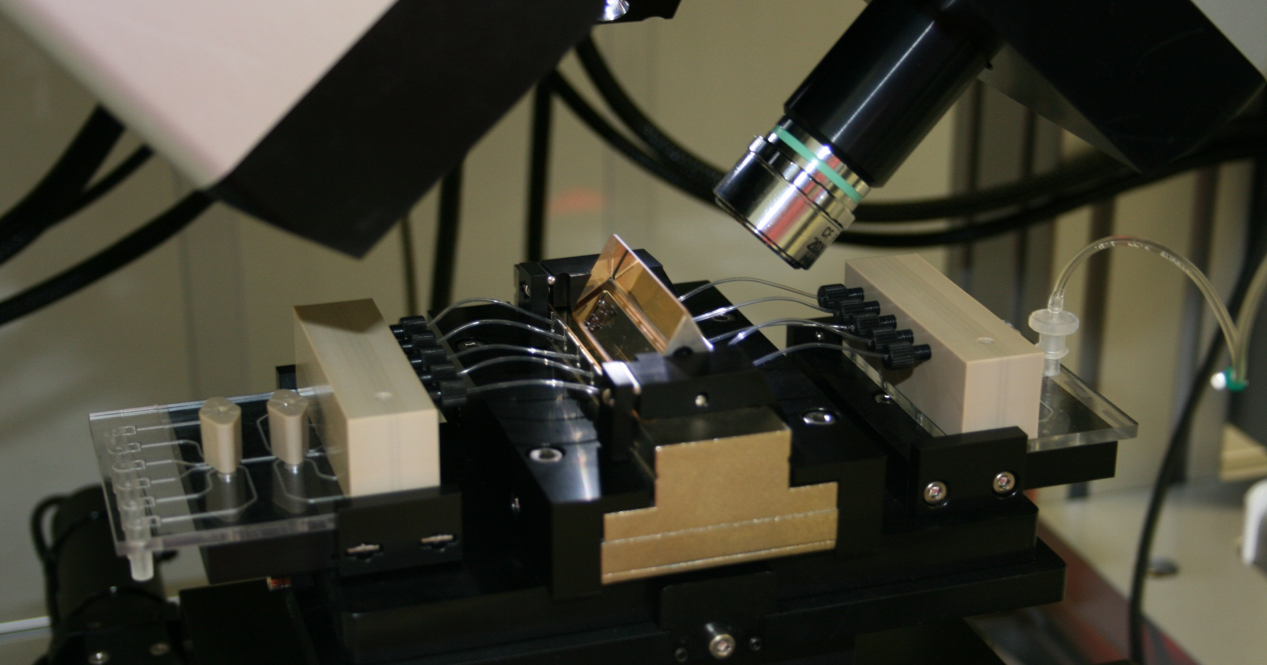
Applications
Surface plasmon resonance (SPR)

Slide 40
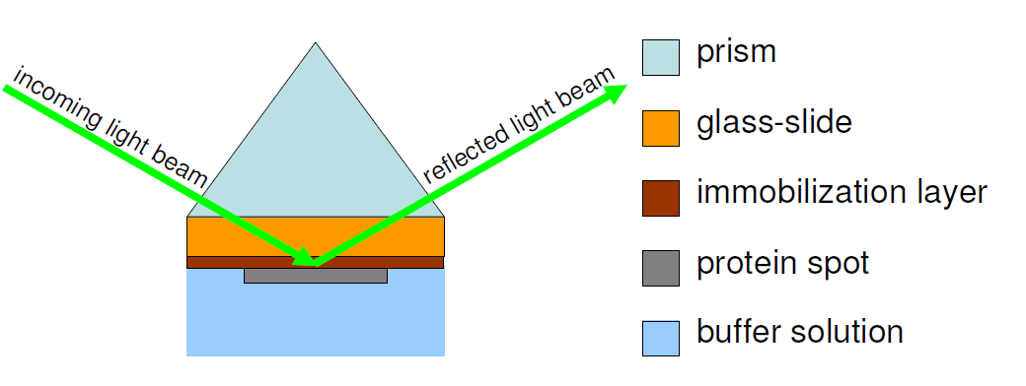
Applications
SPR - Kretschmann Setup

Slide 41
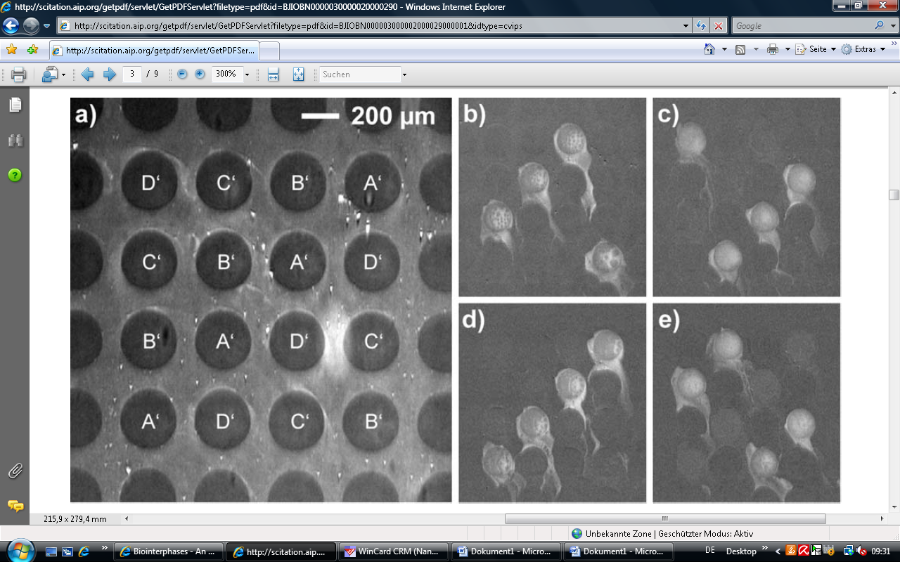
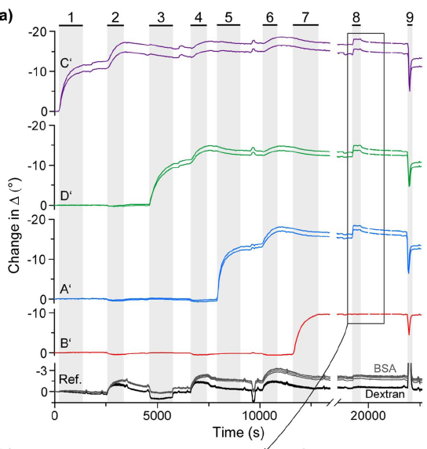
Applications
Surface plasmon resonance (SPR)
Klenkar G, Brian B, Ederth Th, Stengel G, Höök F, Piehler J, Liedberg B (2008) Biointerphases 3: 29-37.
Notes:
41

Slide 42
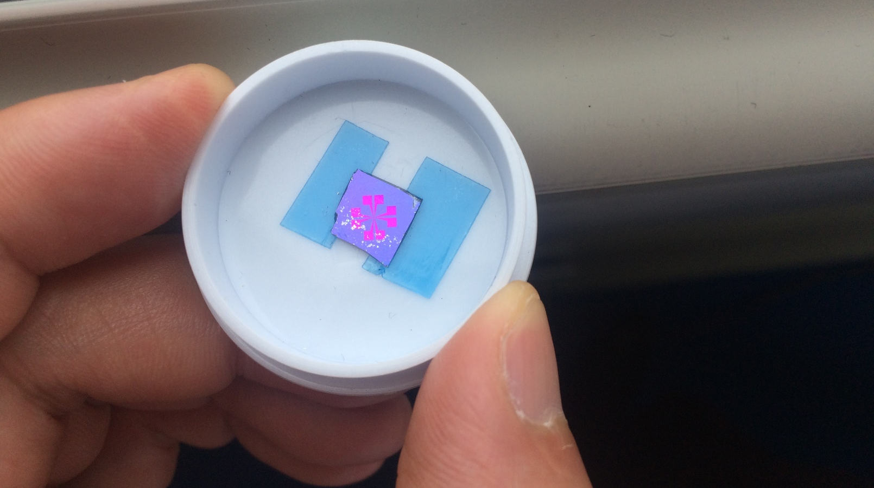
Applications
Graphene
Notes:
42

Slide 43
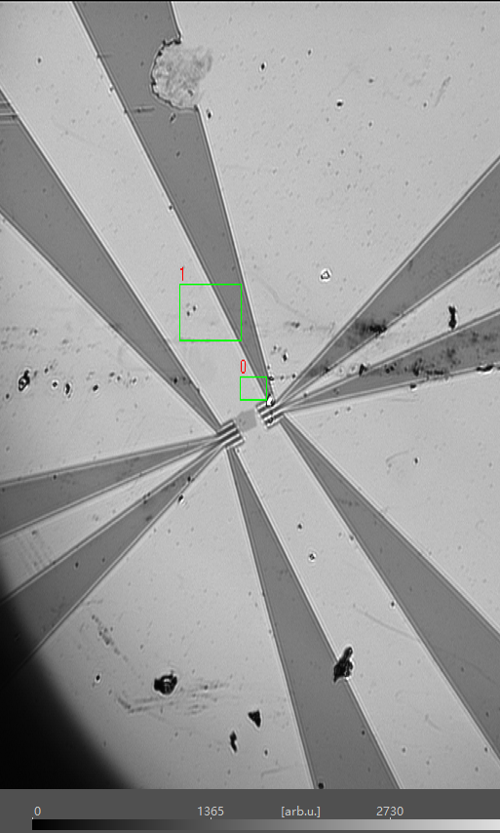
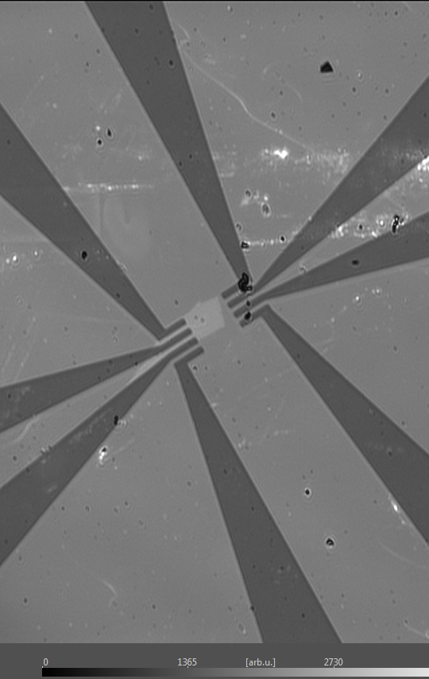
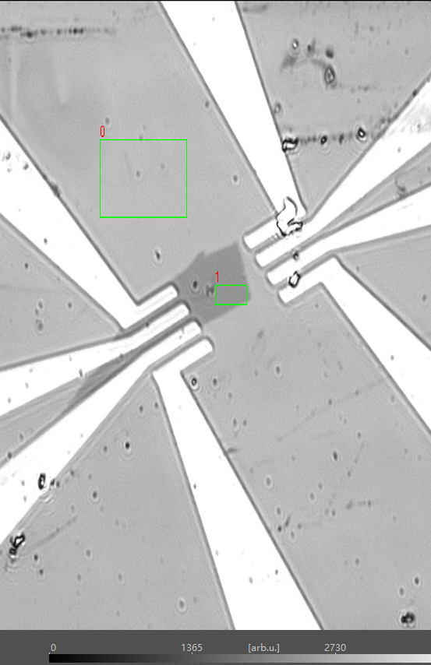
Applications
Graphene
Notes:
43

Slide 44

Applications
Graphene
Notes:
44

Slide 45

Applications
Graphene
Notes:
45

Slide 46

Applications
Graphene

Slide 47


www.accurion.com
Air|Graphene|SiO2|Si Delta map

Slide 48

???
For any questions, do not hesitate to contact the Accurion Team!
Accurion GmbH
Stresemannstrasse 30
37079 Goettingen, Germany
Phone: +49-[0]551.999 60.0
Fax: +49-[0]551.999 60.10
E-Mail: info@accurion.com
Web: www.accurion.com

